Slide 1


Climate impacts on ovigerous lobster behavior and the downstream effects on larval dispersal and settlement
Andrew Goode and Everett Rzeszowski
University of Maine

Slide 2
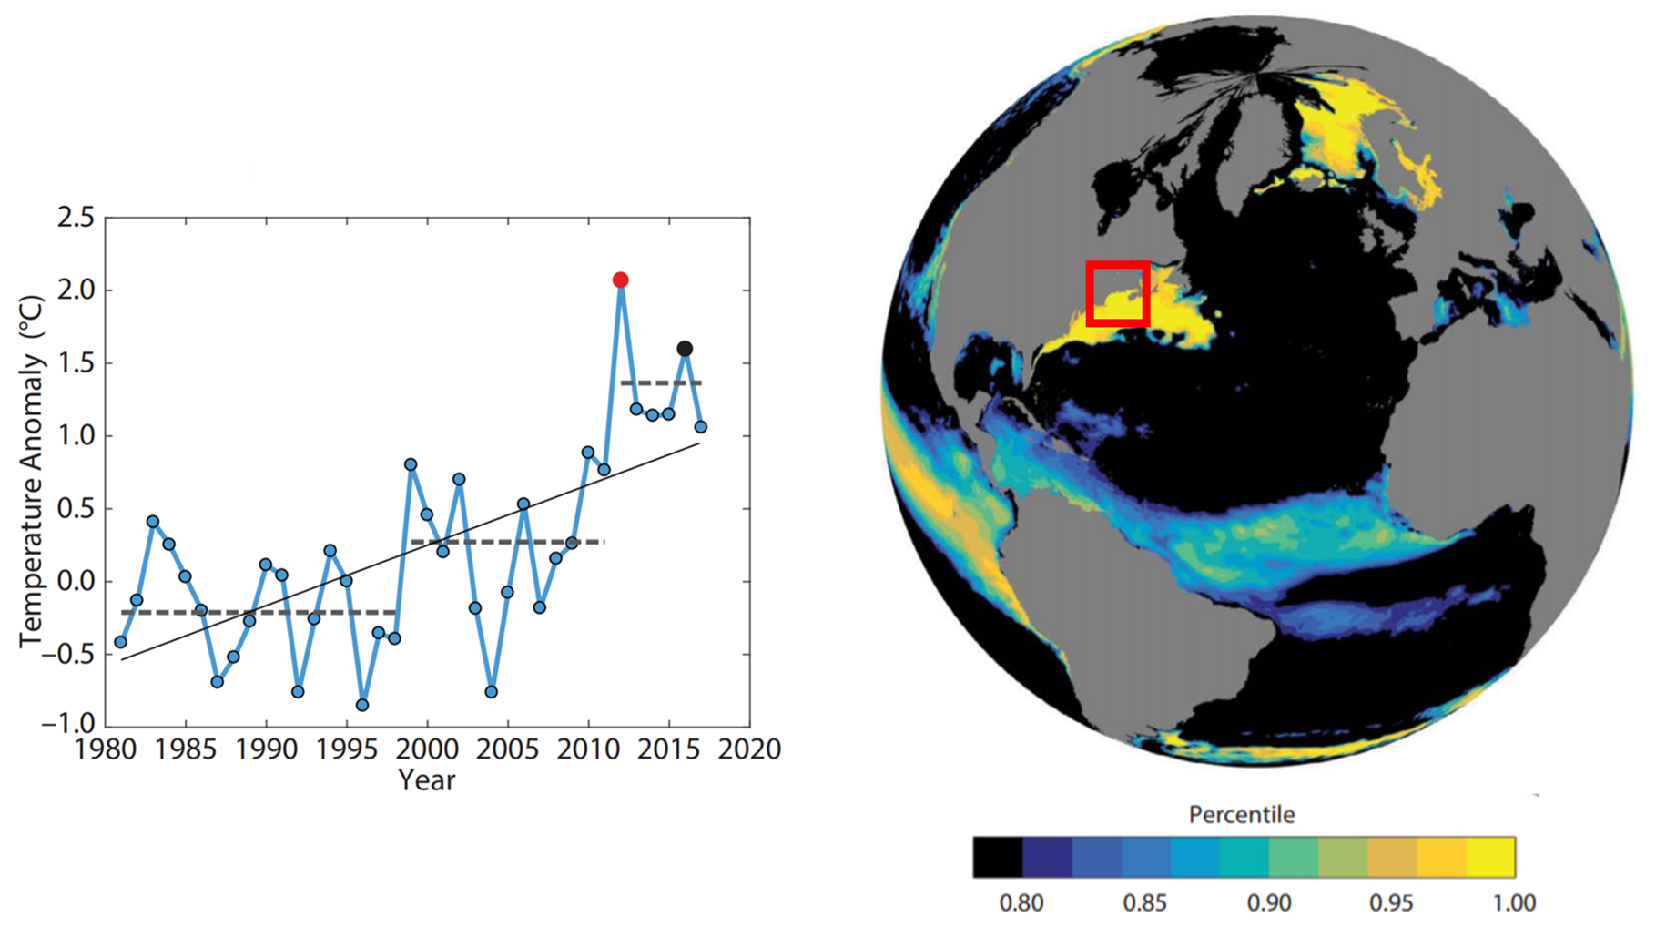
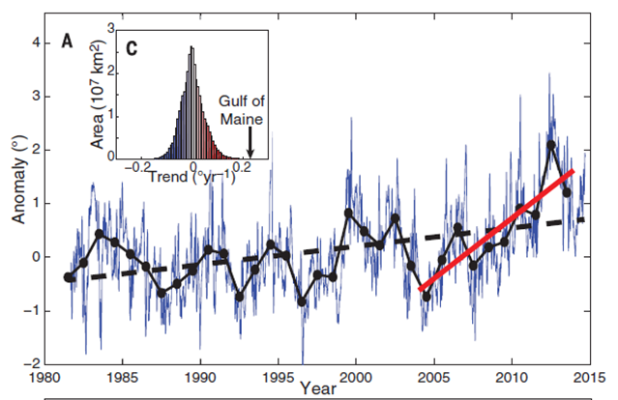
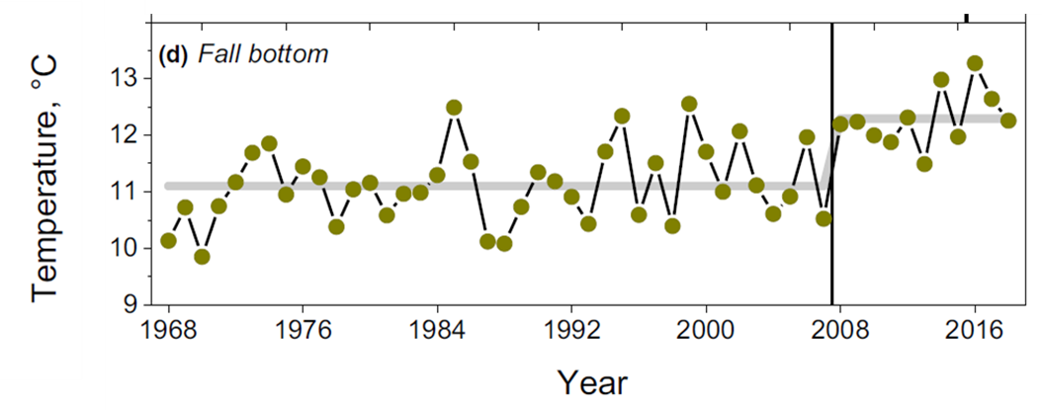
Gulf of Maine Warming
Rapid, non-linear warming
Thermal regime shift ~2008
Climate scenarios predict continued warming
Why?
Pershing et al. (2018)
Pershing et al. (2015)
Friedland et al. (2020)

Slide 3
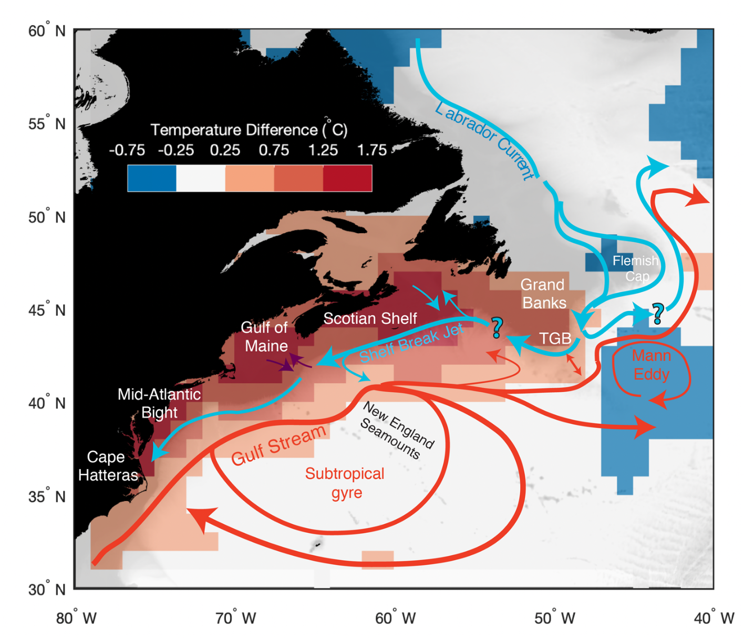
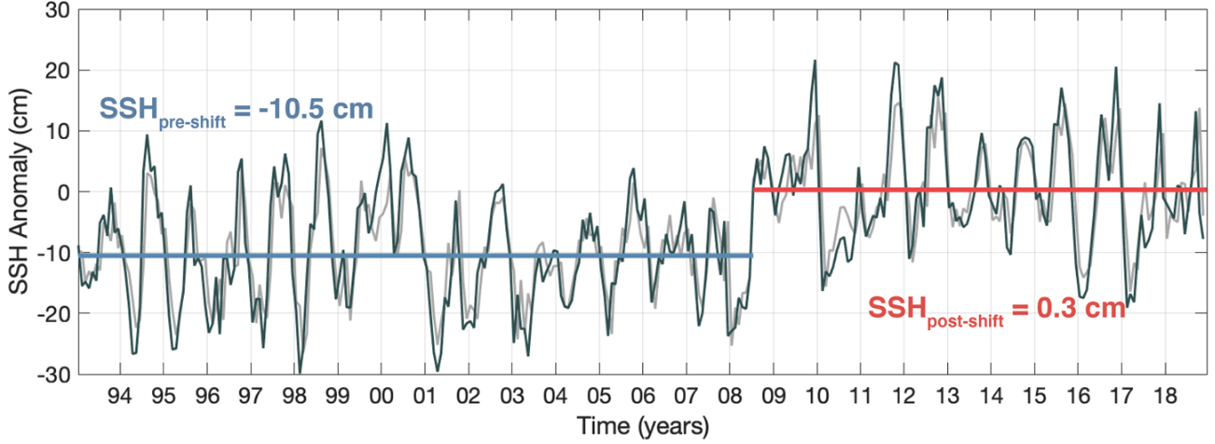
Gulf Stream Impingement
As the Gulf Stream shifts northward it pinches off subarctic currents at the Tail of the Grand Banks
This impacts the water masses entering the Gulf of Maine
Changing circulation in the Northwest Atlantic with mean temperature difference between 2001-2007 and 2009-2017 (Top); SSH shift in 2008 at TGB, representing GS impingement (Left); Neto et al. 2021

Slide 4
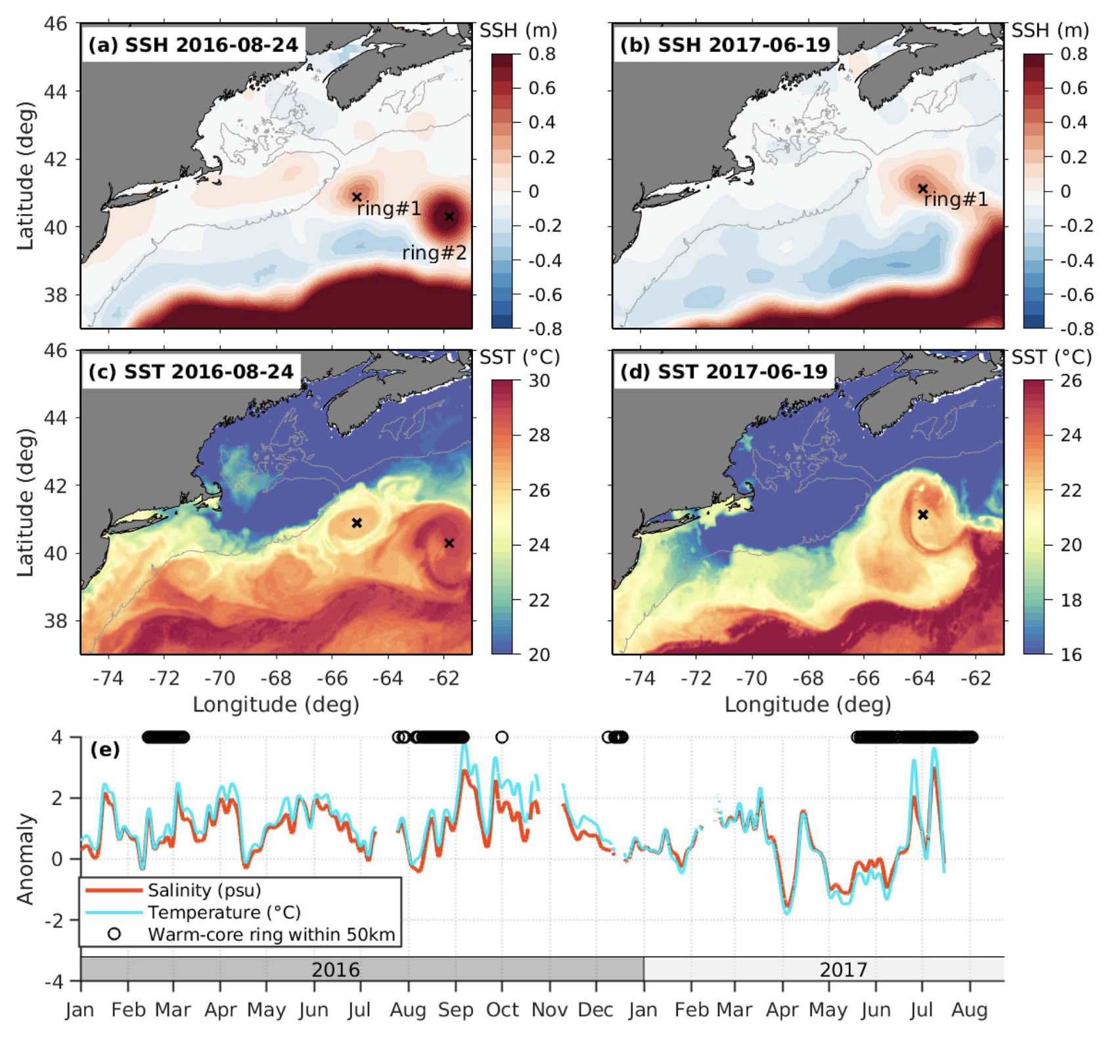
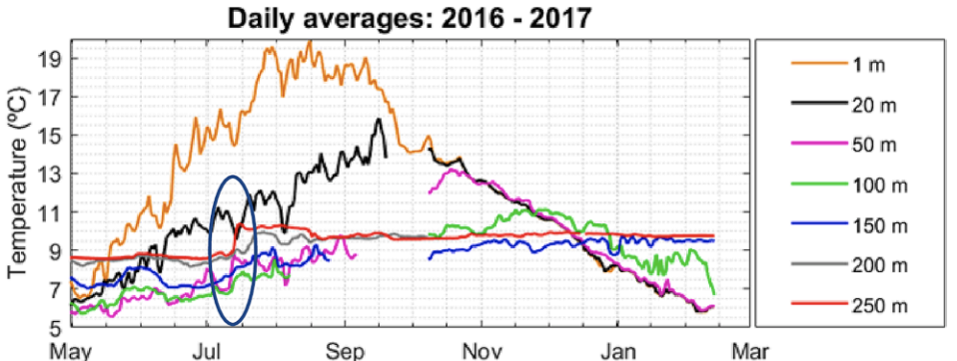
Warm Water Intrusions
Individual benthic warming events increase in frequency as Gulf Stream shifts.
Gulf Stream warm core rings as seen in satellite images influence deep basin warming in the Gulf of Maine (Right, Du et al. 2021; Buoy M, Top, Townsend et al. 2023)

Slide 5
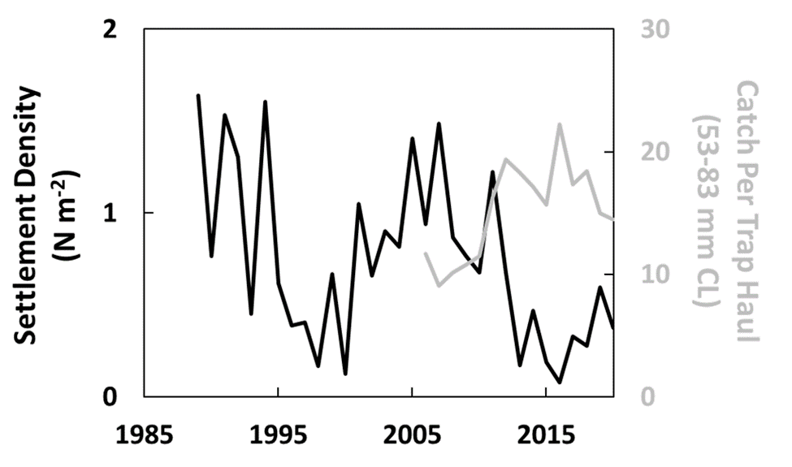
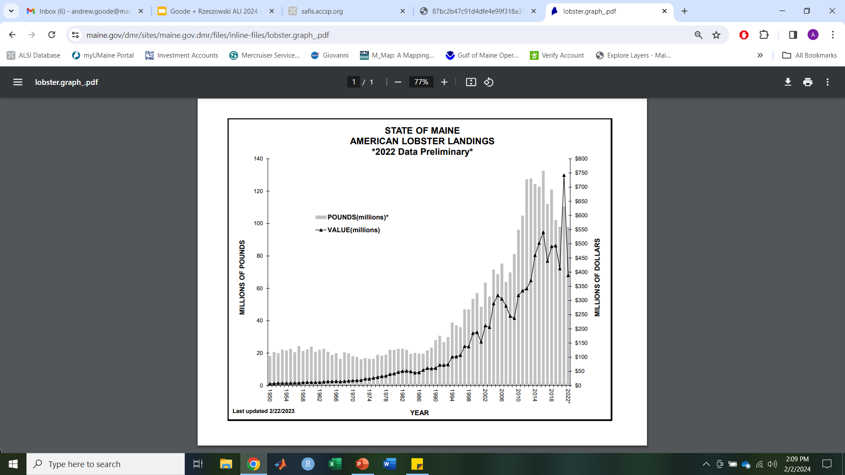
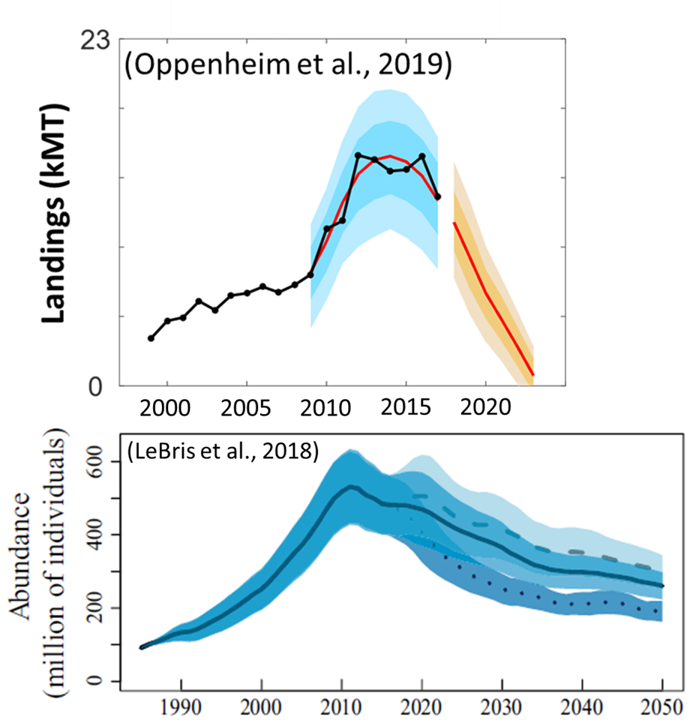
Fishery Changes
Historical Maine lobster landings (ME DMR; top)
Lobster Settlement density and predicted landings trends (right).

Slide 6
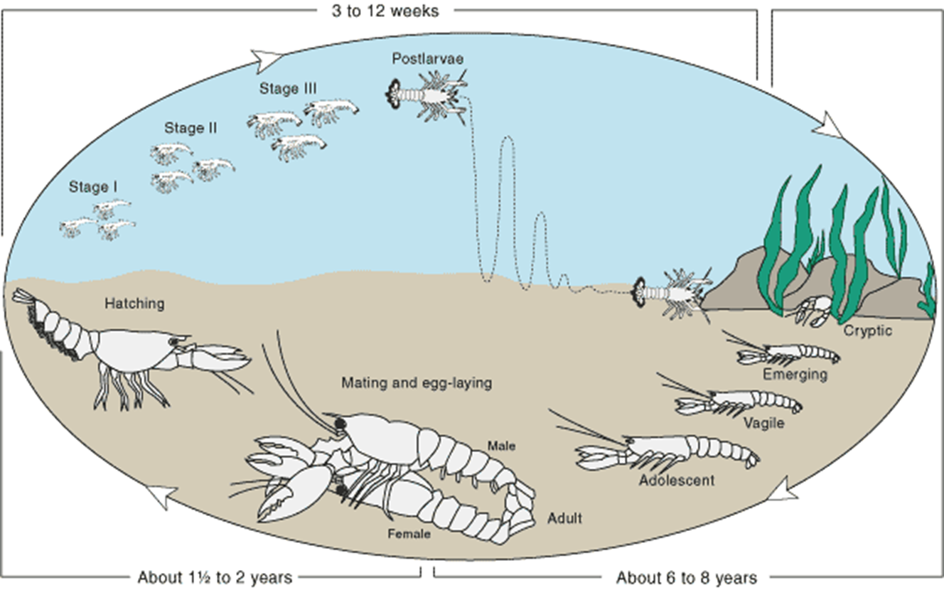
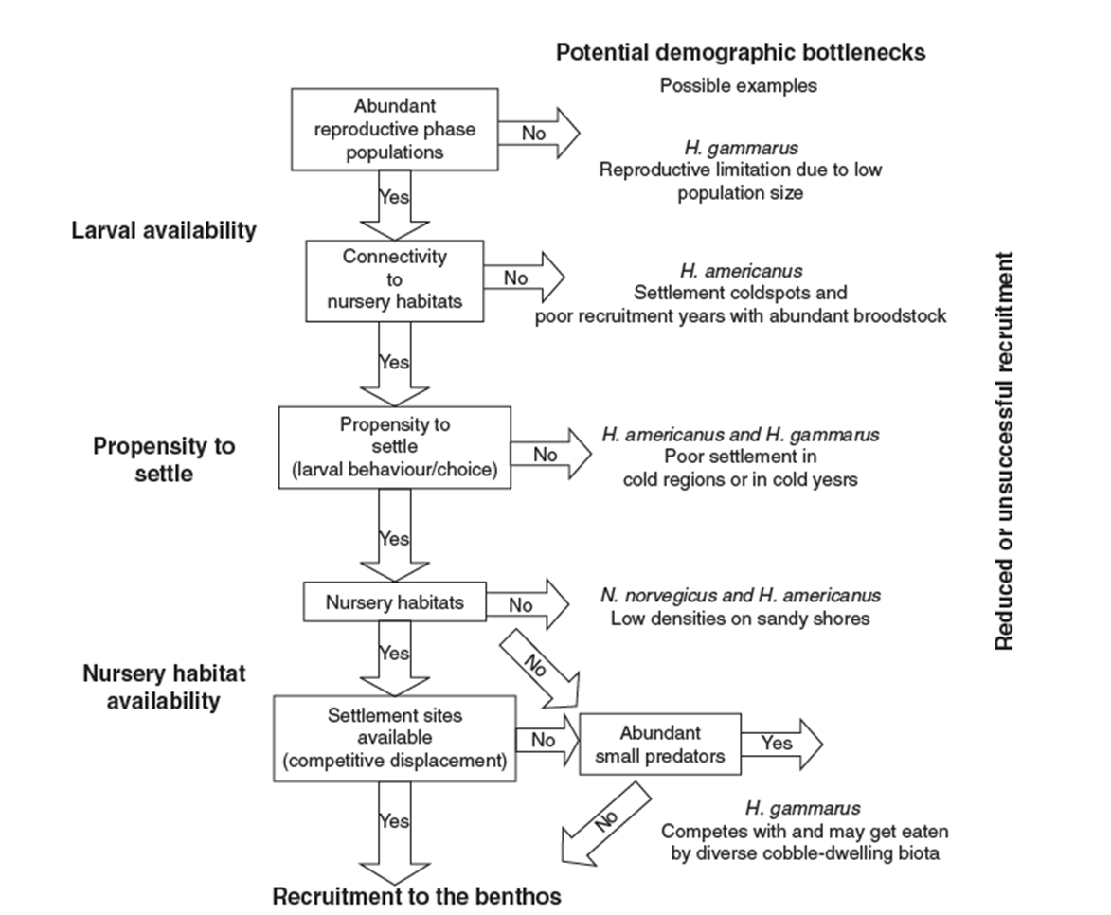
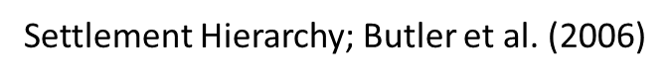
Implications:
Lobster Life History
Lobster Life History
Settlement driven demography:
Larval availability, propensity to settle, nursery habitat availability
(sub)Adult behavior:
Reproduction and distribution
How does climate change impact these critical aspects of lobster life history?

Slide 7
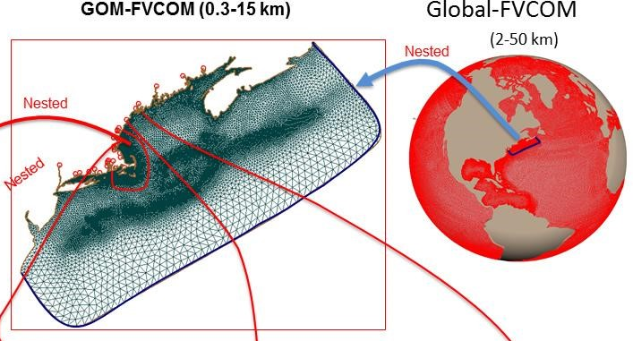
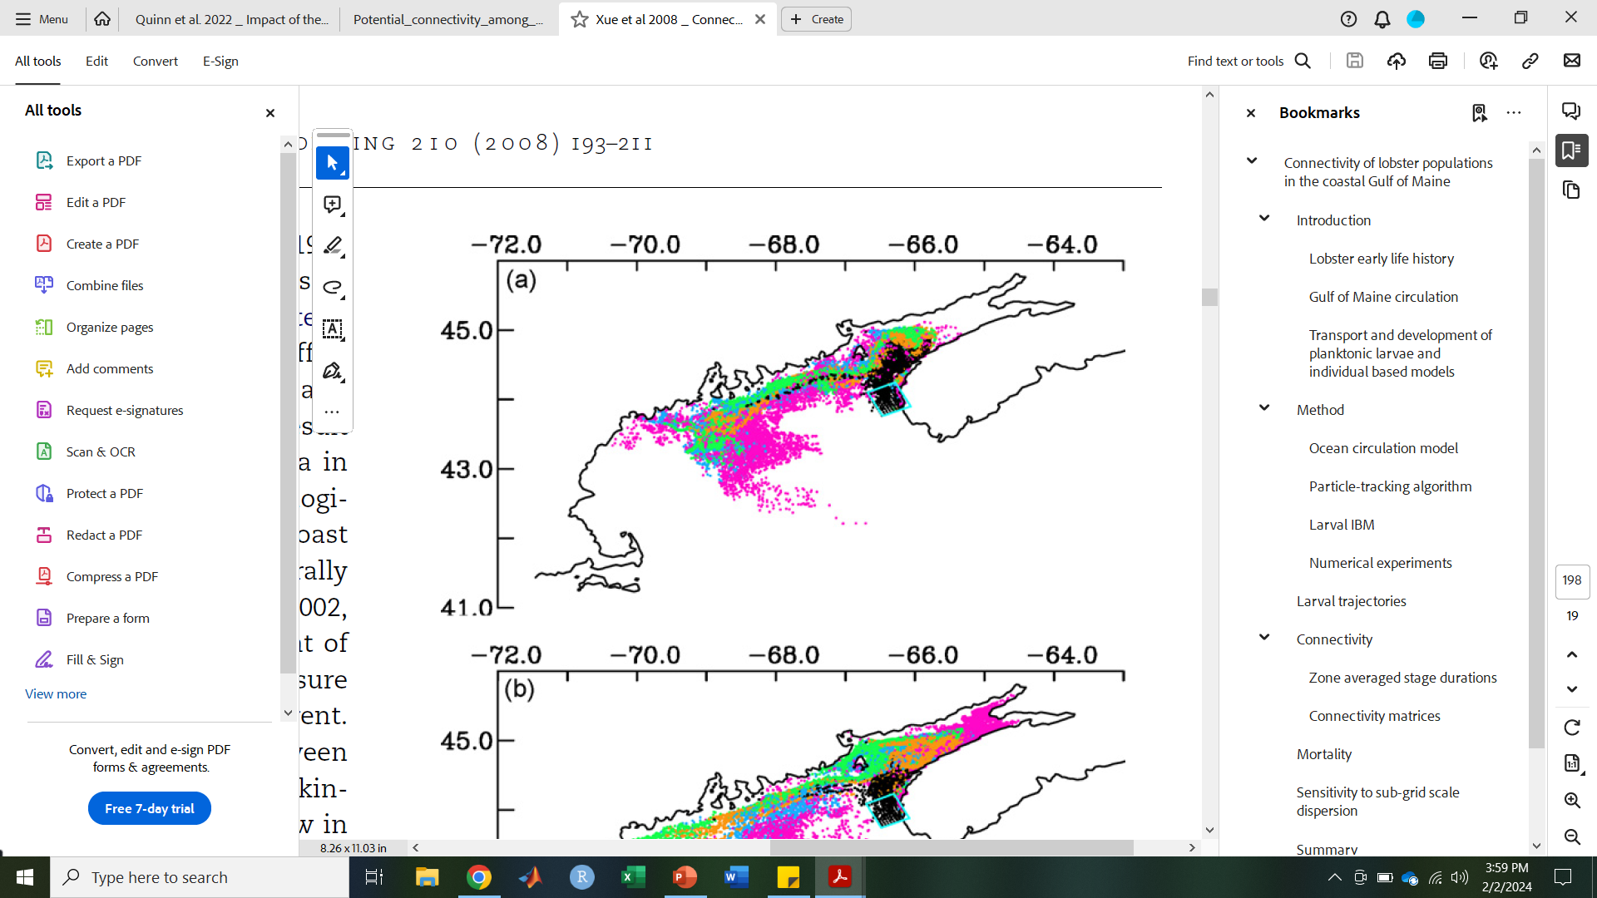
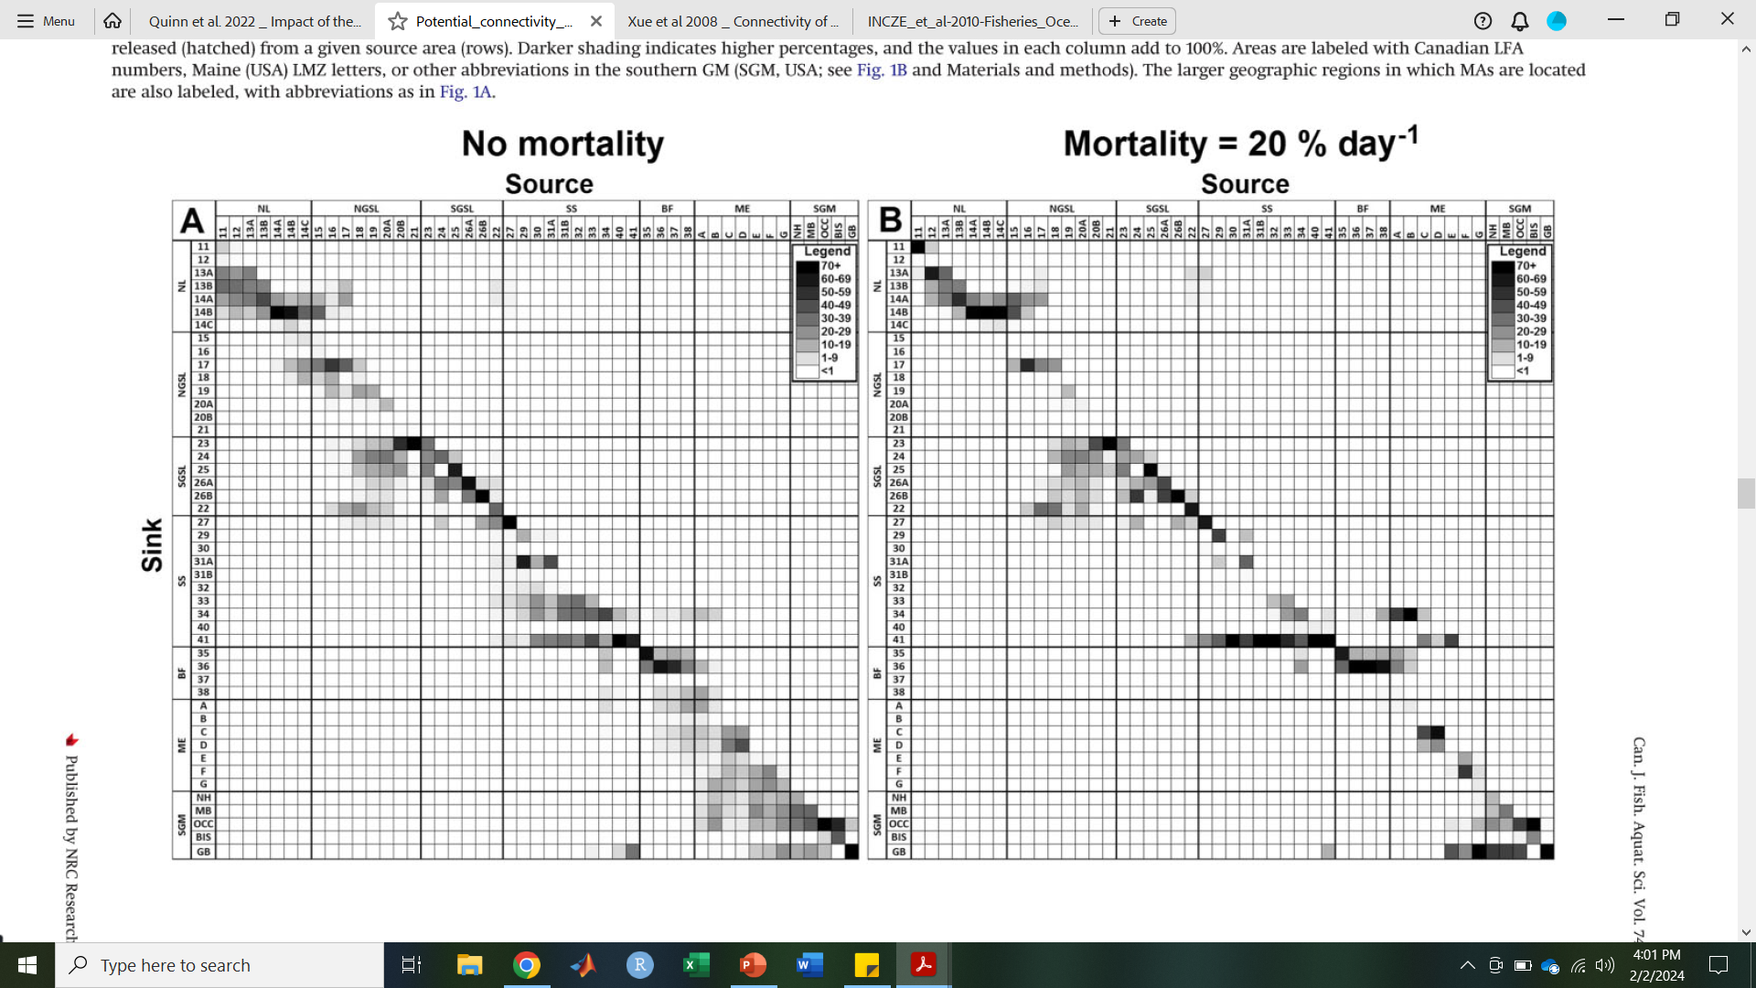
How?
Larval particle tracking using NECOFS (right)
Previous Work:
Lobster particle tracking (Xue et al., 2008; Incze et al. 2010; Quinn, 2017)
Consistent locations, release dates, and larval mortality
How does incorporating climate impacts to these parameters impact larval connectivity?

Slide 8
Integrated Research
Climate Change / Ocean Warming
Female
Distribution
Reproductive
Phenology
Trophic
Influences
Settlement
Regulation
Larval
Dispersal / Connectivity / Settlement
Year Class Strength
Landings
Predictions

Slide 9
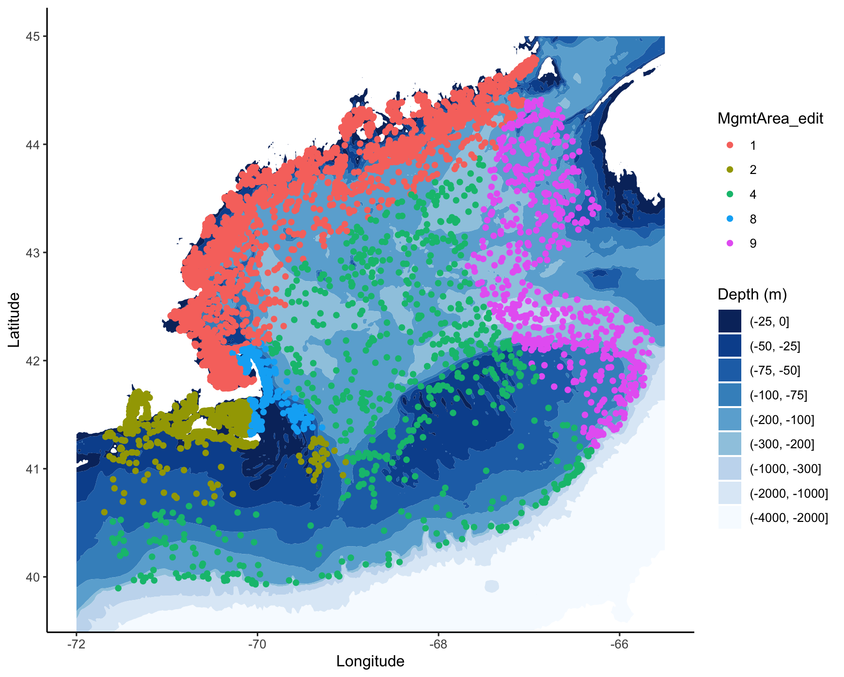
Female Distribution
Model Female Biomass in Spring Trawl Surveys from:
MENH Inshore Trawl Survey
MA Inshore Bottom Trawl Survey
RI Coastal Trawl Survey
NEFSC Bottom Trawl Survey
Abundance of Females> 75 mm CL

Slide 10
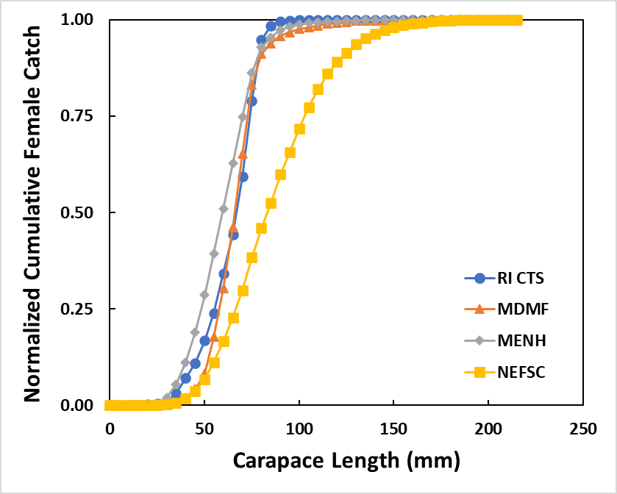
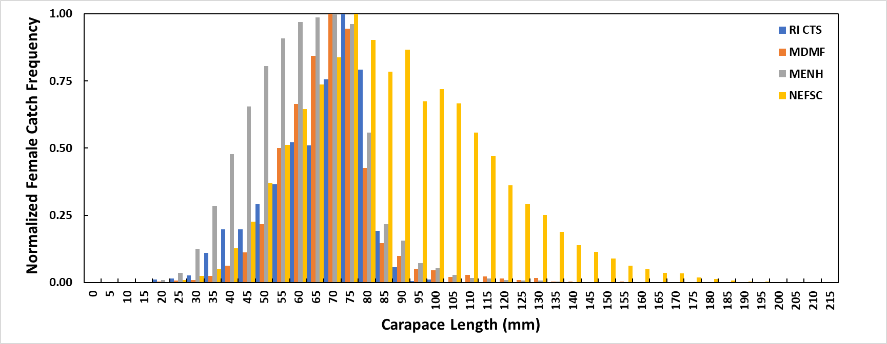
Female Distribution
Standardization of catch
Females km⁻² ~ Catch / (Trawl length * Trawl Width)
Catchability by trawl type?

Slide 11
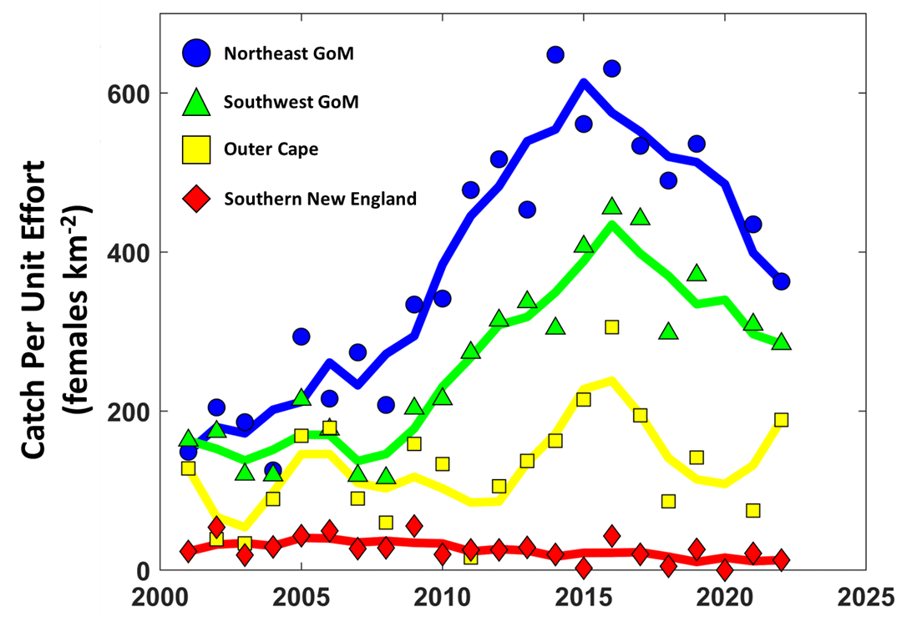
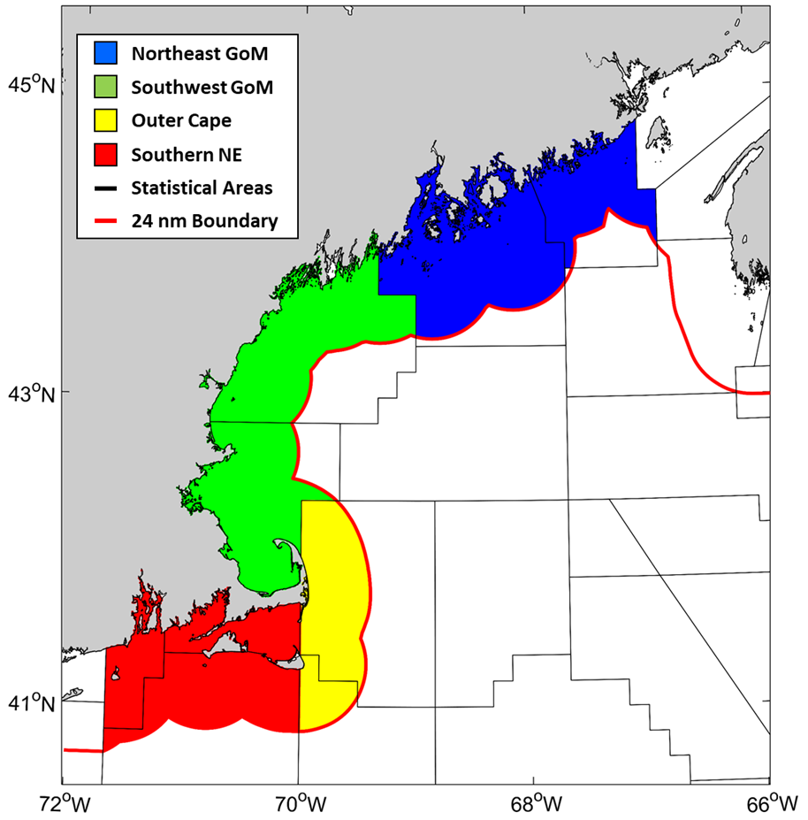
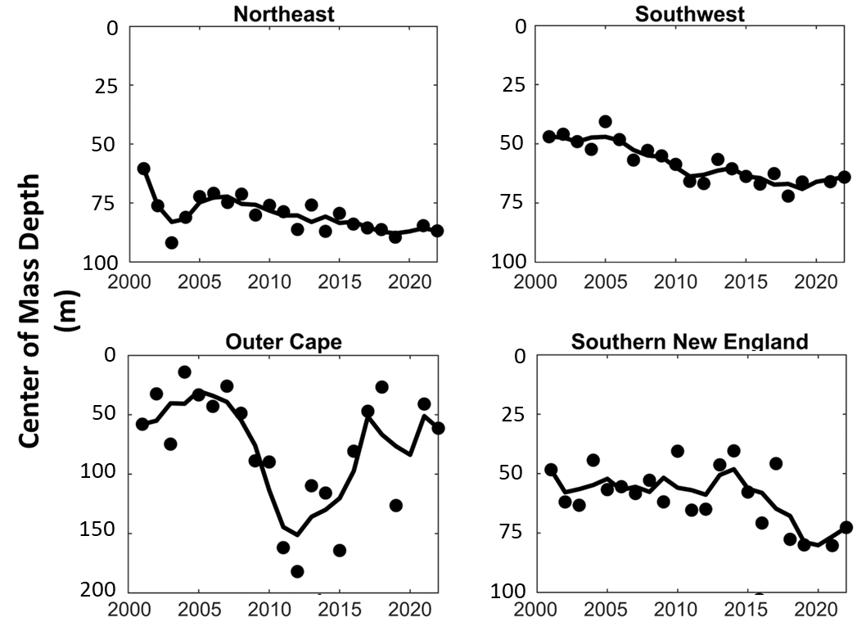
Female Distribution

Slide 12
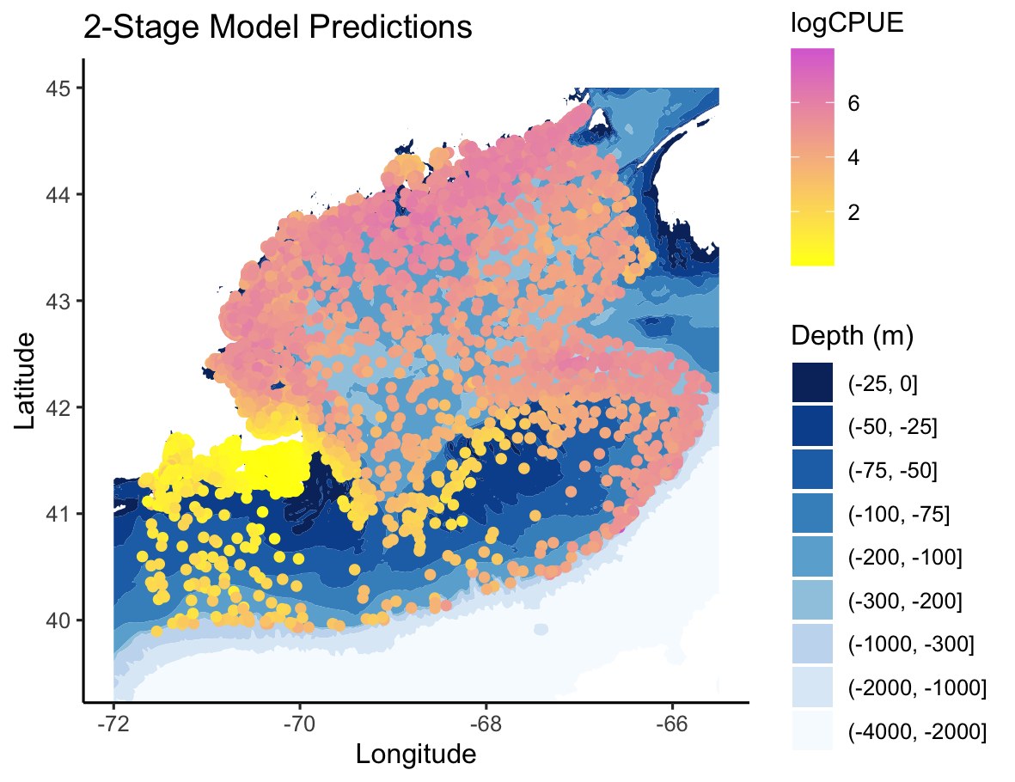
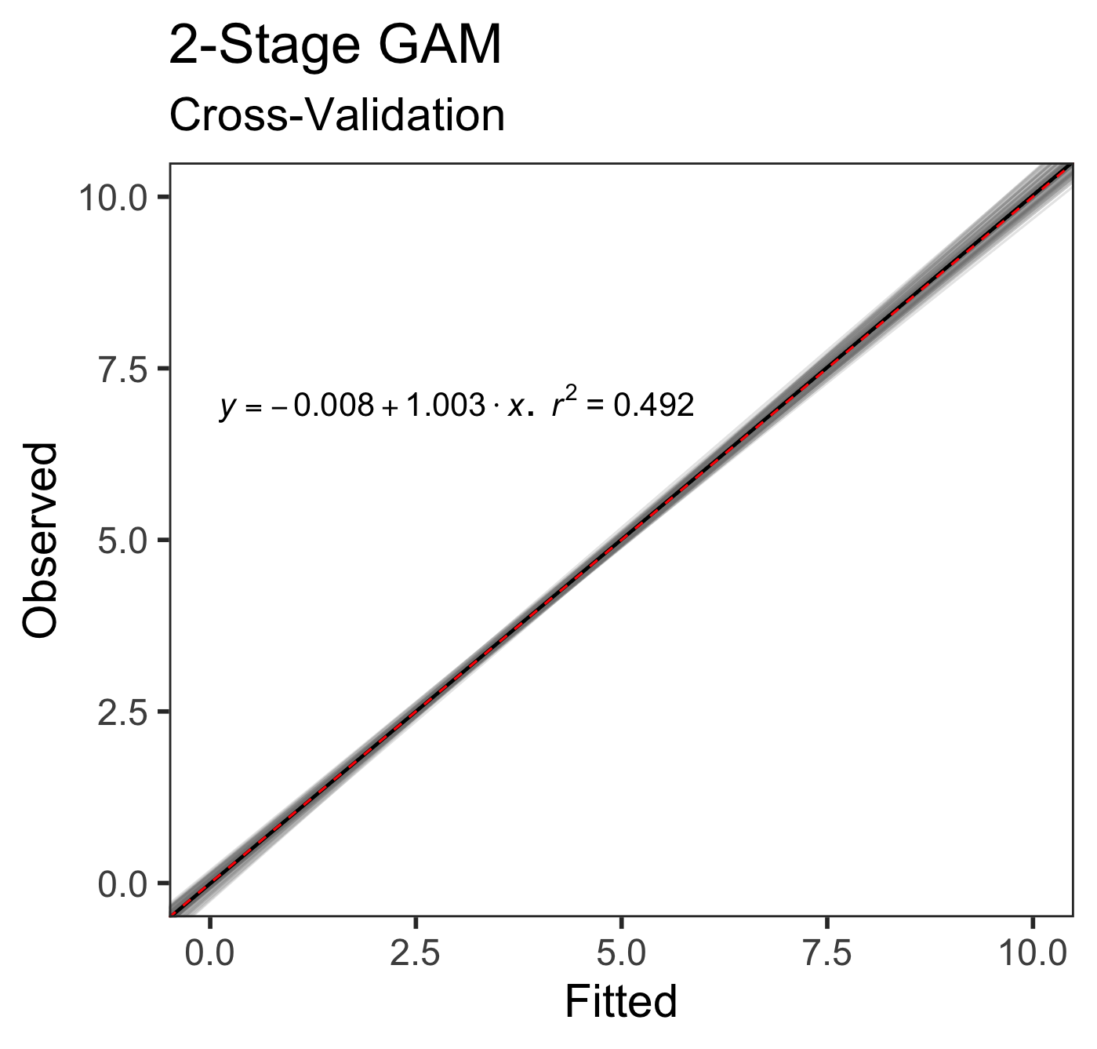
Modeling Female SSB Distribution
2 Stage GAMs describe changing female distributions and performed well.
Full data model
Annual models
Regime shift models
Mapped 2 Stage model predictions (Top).
Model cross-validation (Left).

Slide 13
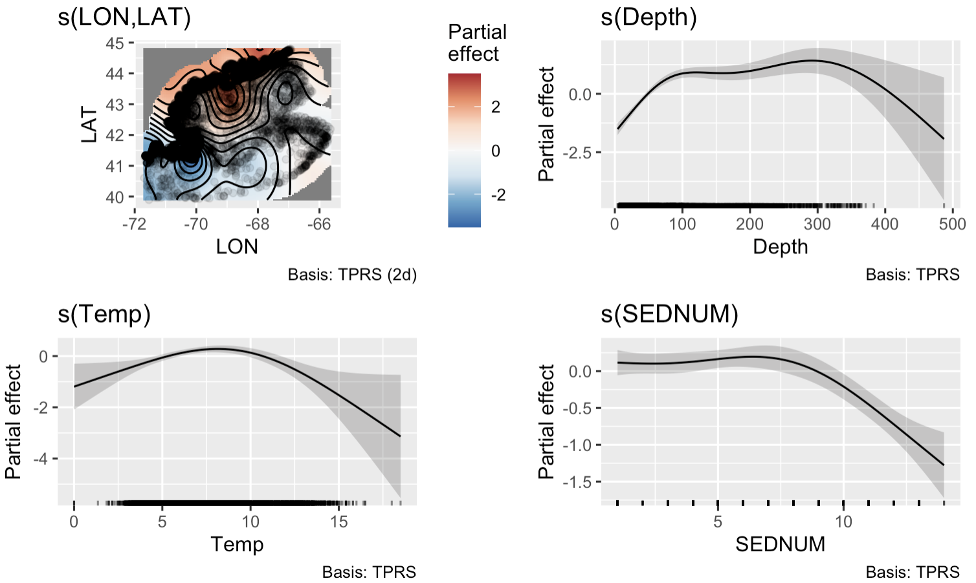
Presence / Absence
Probability of Presence in a trawl sample:
Is higher in LMA 1; Central GOM
Increases 0 - 100 m; decreases >300m
Decreases >9°C
Decreases on clay sediment.
Clay
Hard-Bottom
Partial effects of covariates included in the final presence / absence probability model.

Slide 14
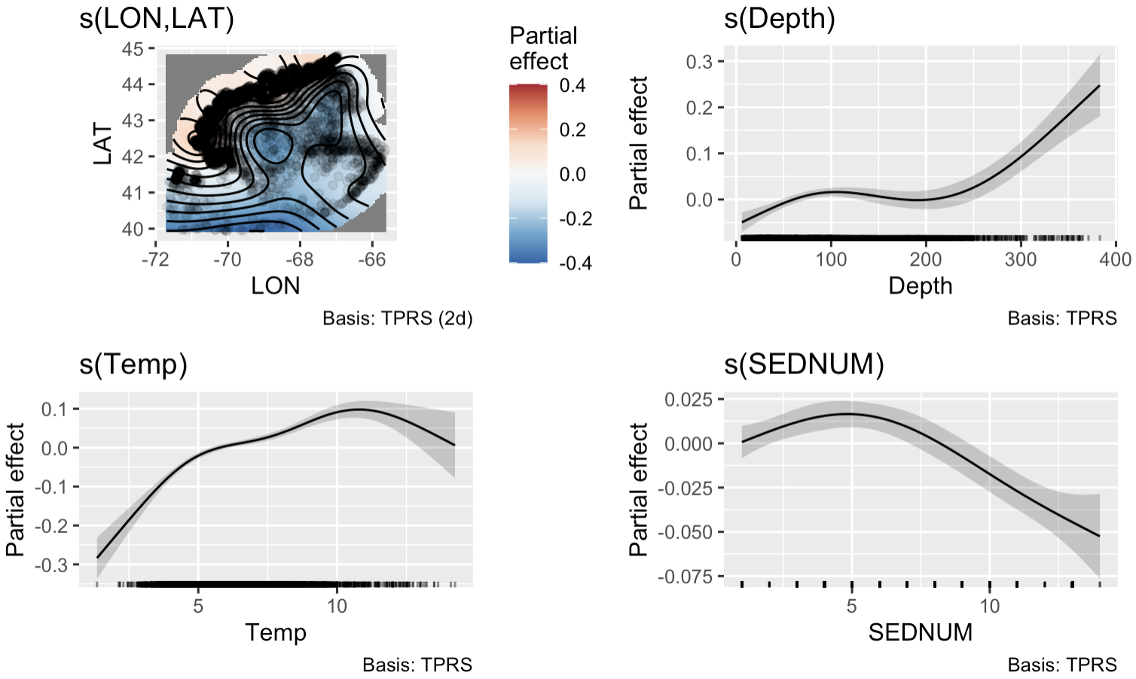
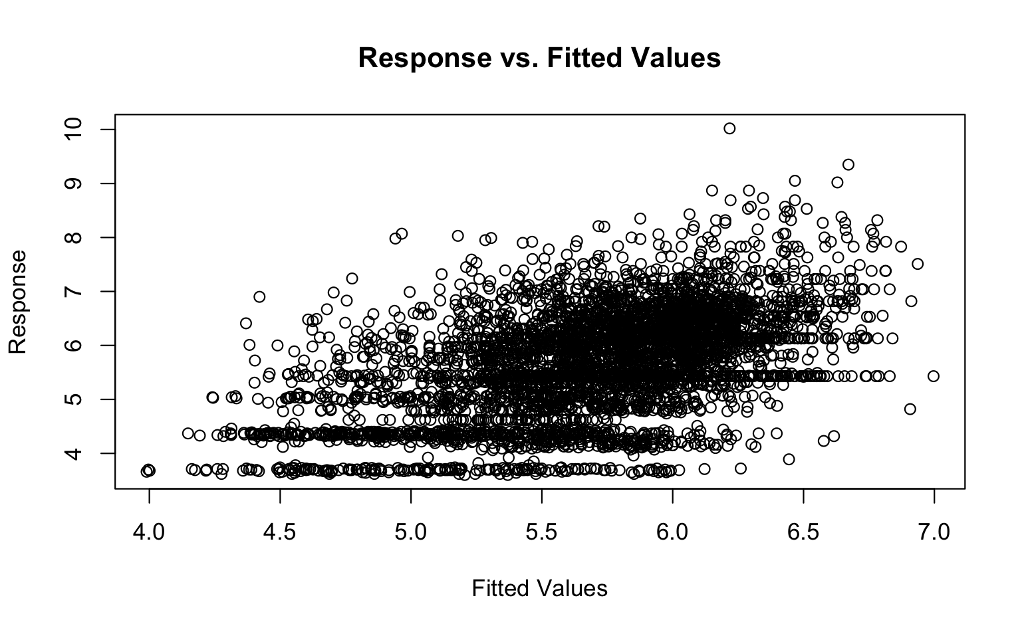
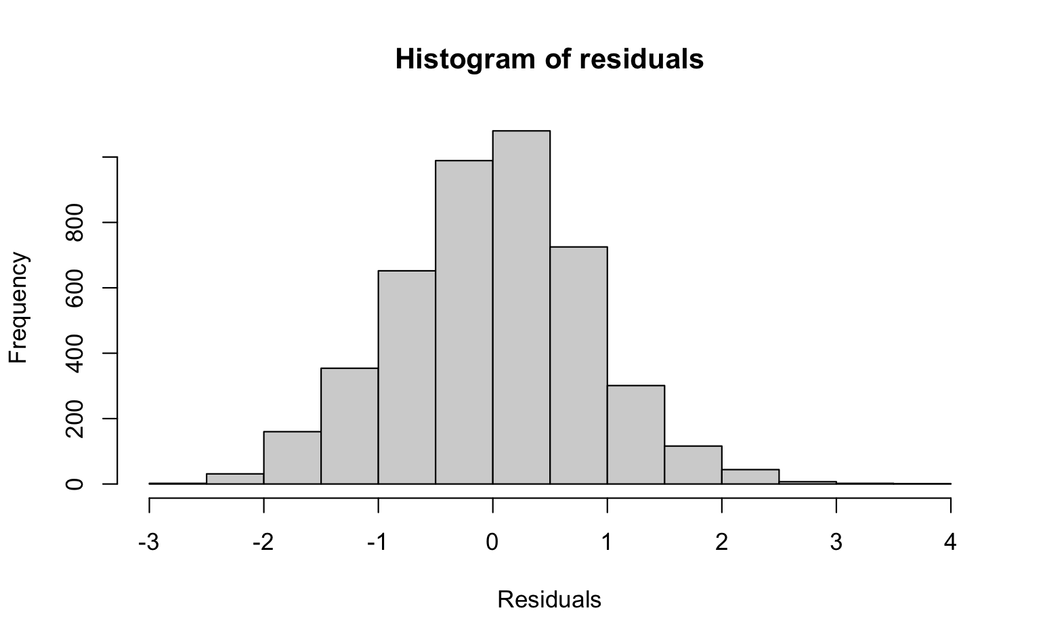
CPUE
CPUE is:
Higher in LMA 1 offshore regions
Increases from 0 - 10°C
Increases from 0 - 100 and >300m
Highest over sand / gravel bottom and decreasing over silt / clay.
Clay
Hard-Bottom
Partial effects of covariates included in the final logCPUE model (Top). Response vs. fitted values and model stage residuals (Left).

Slide 15
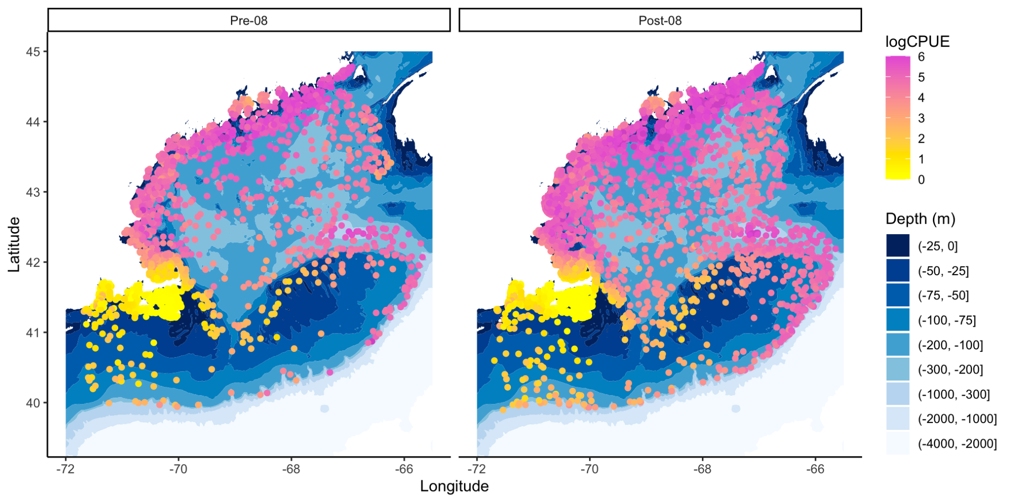
Grouping Model Output
Model predictions aggregated around oceanographic change point year.

Slide 16
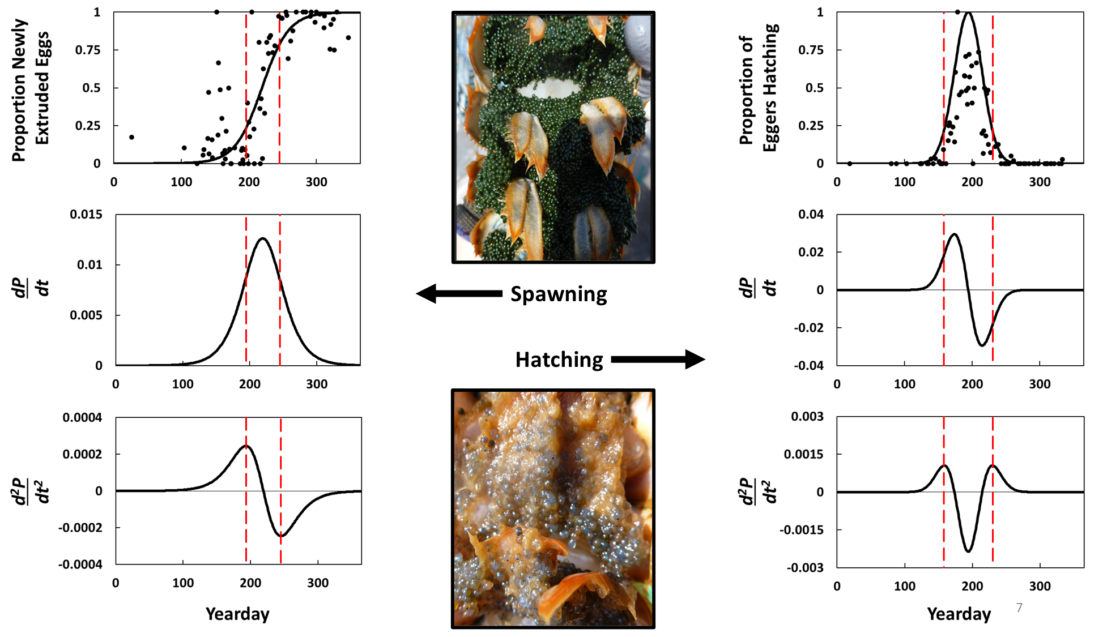
Reproductive Phenology
Ventless Trap and Sea Sampling Surveys
ME DMR
MA DMF
RI DEM
Proportion of ovigerous females spawning / hatching eggs

Slide 17
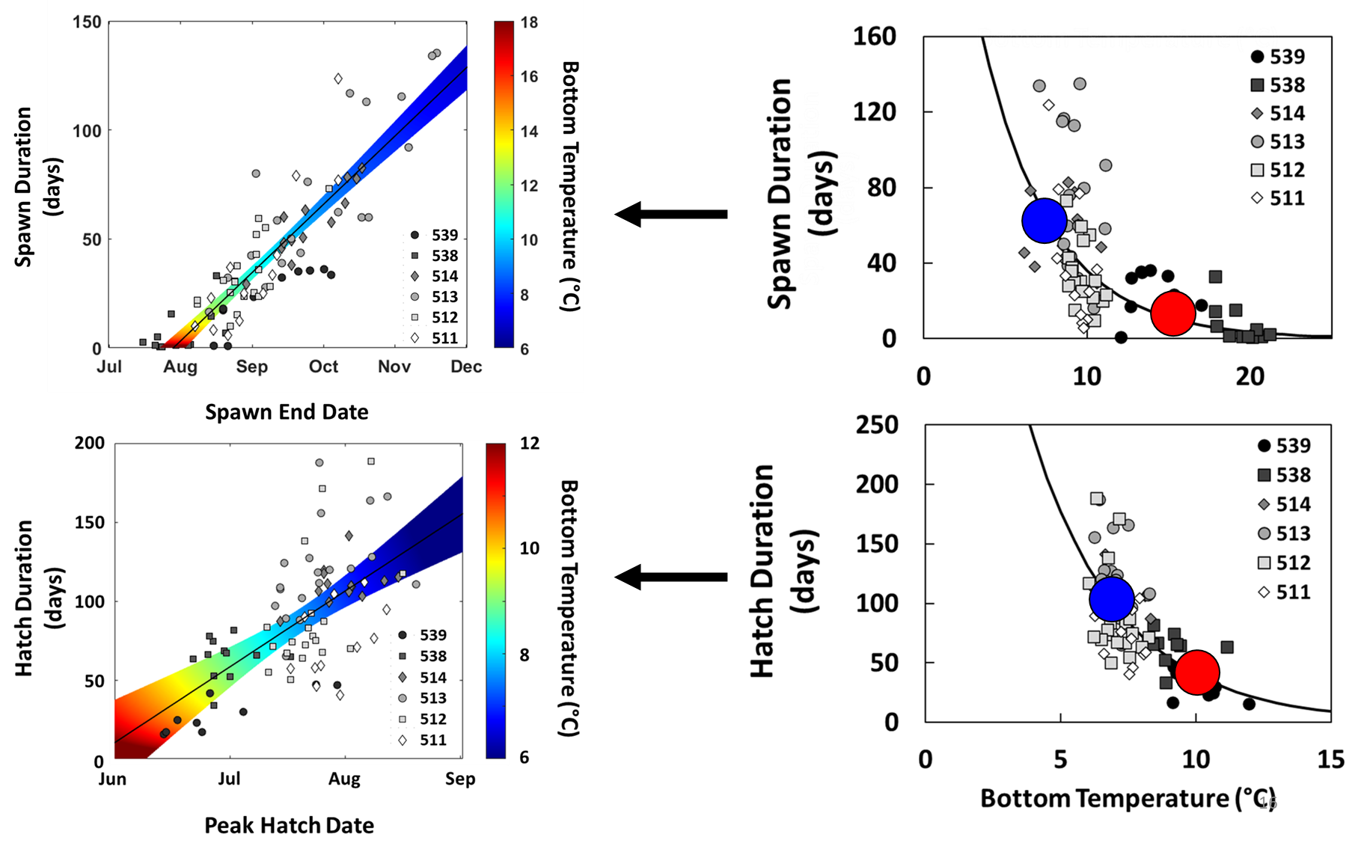
Reproductive Phenology

Slide 18
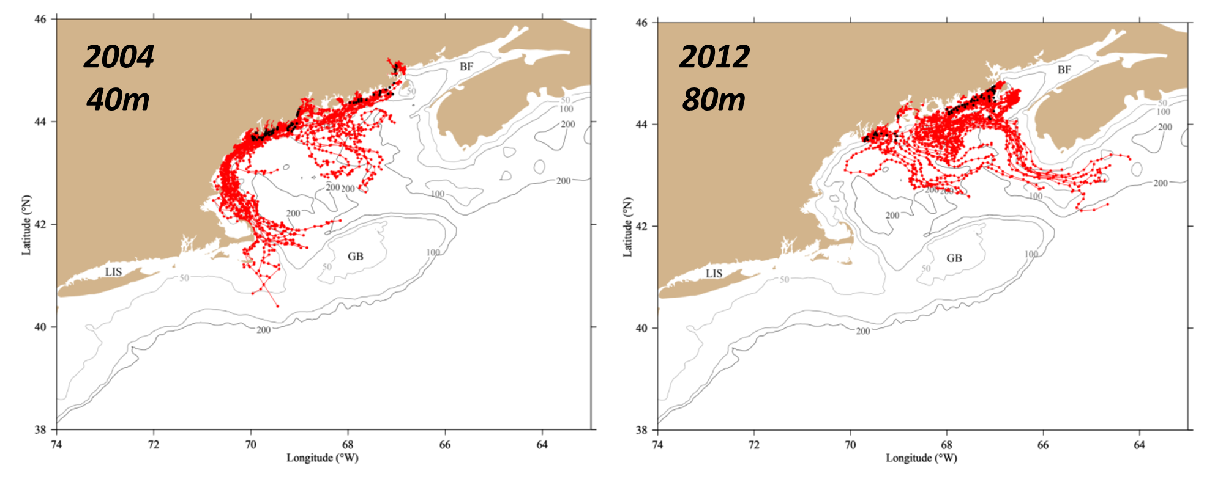
Implications to Larval Trajectories

Slide 19
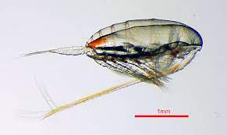
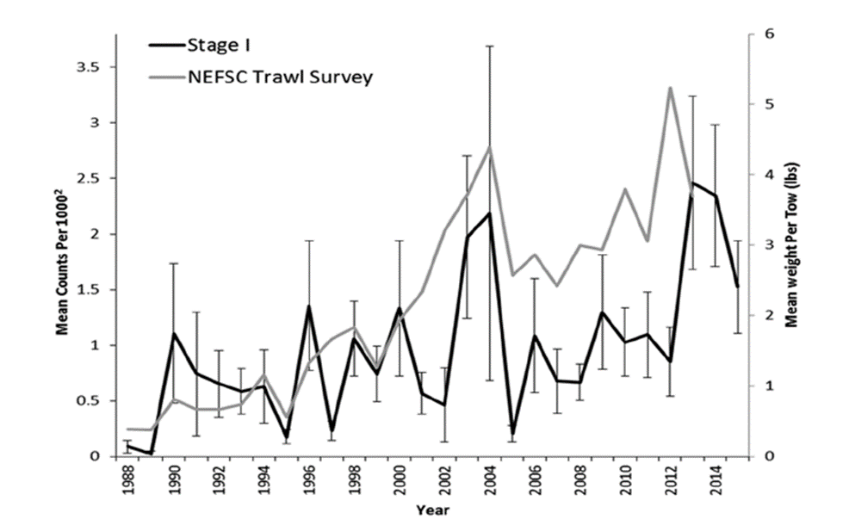
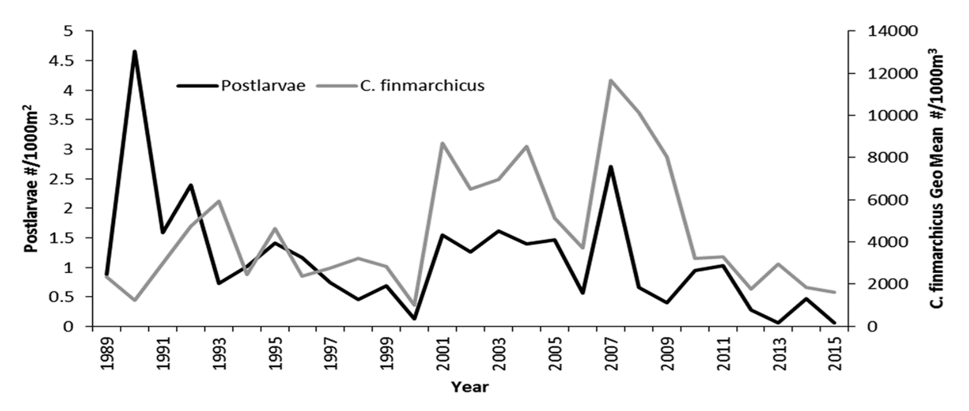
Trophic Influences
Stage I larvae increase with increases in SSB
Stage I increases but Stage IV decreases
Postlarval abundance declines track similar declines in Calanus finmarchicus
Carloni et al. (2018)

Slide 20
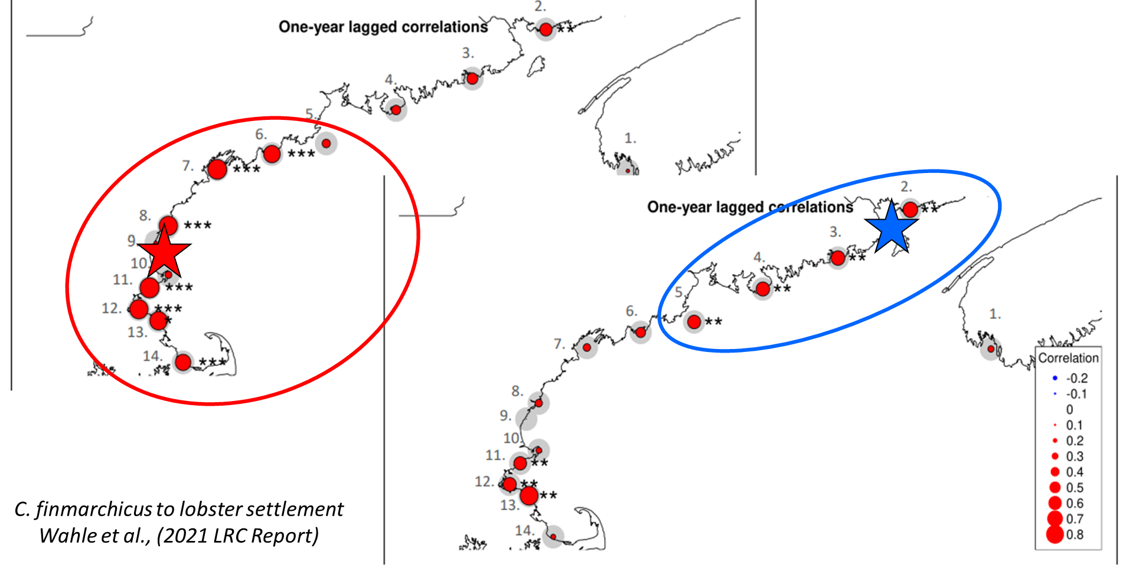
Trophic Influences

Slide 21
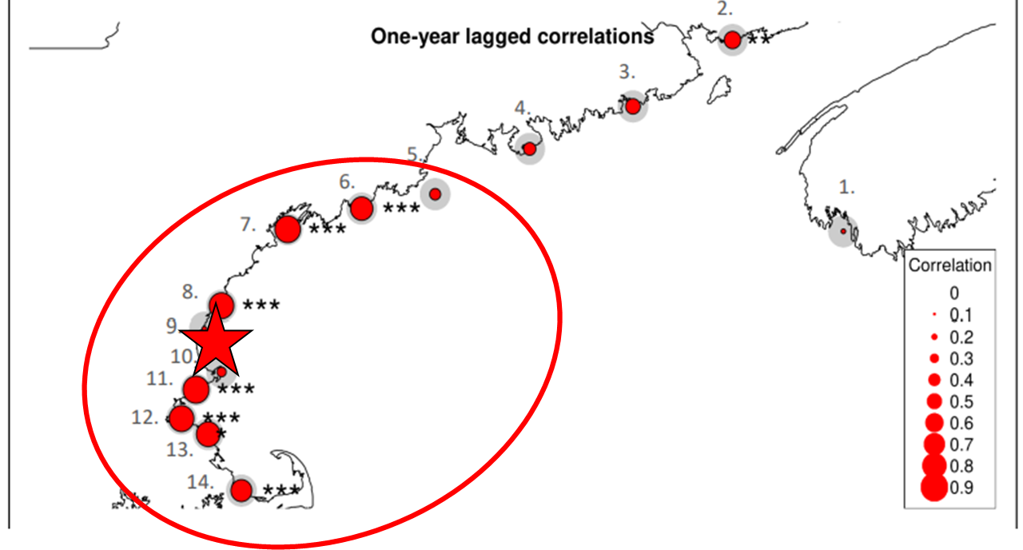
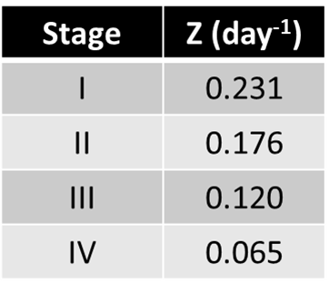
Trophic Influences
Training using particle tracks and Seabrook data
Calanus-modified natural mortality to recreate SIV patterns
Seabrook and PIV C.fin for GoM mortality

Slide 22
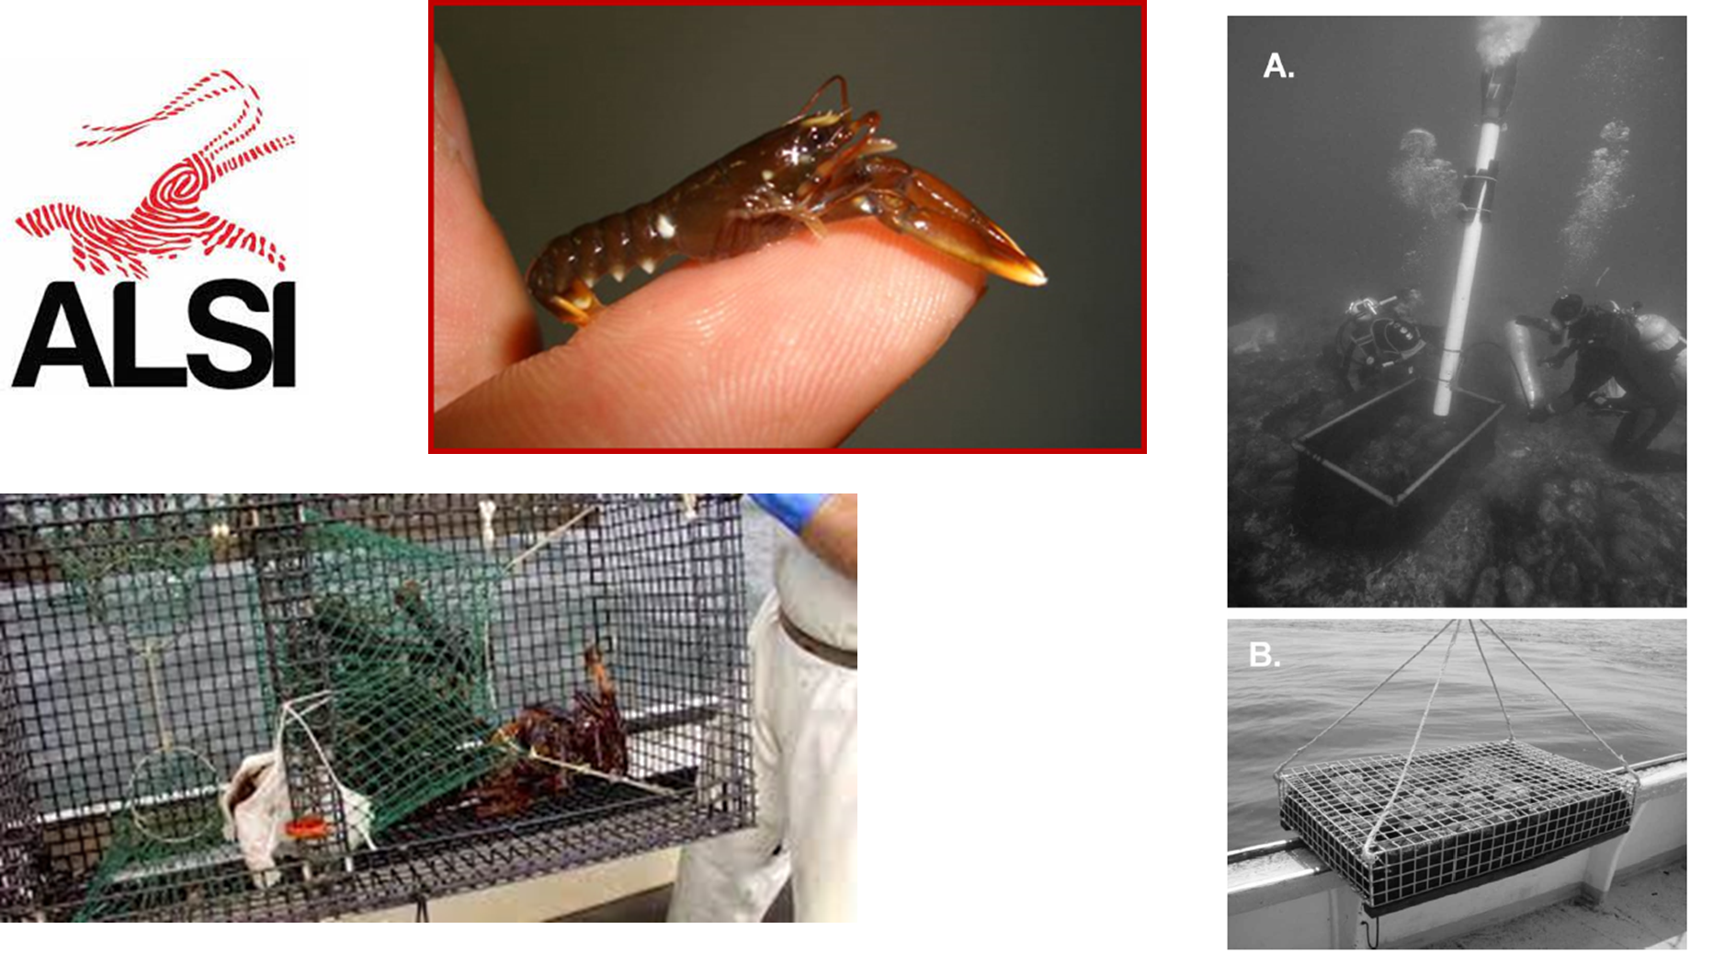
Settlement Regulation

Slide 23
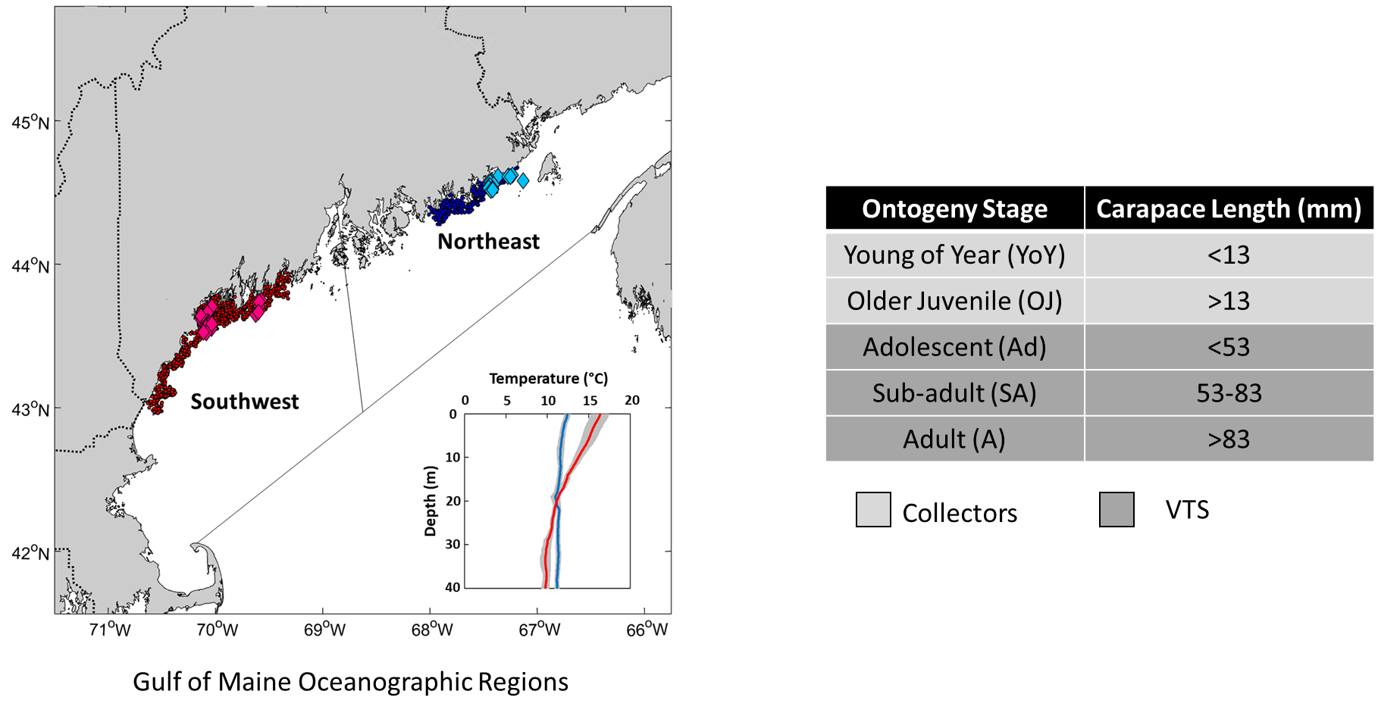
Settlement Regulation

Slide 24
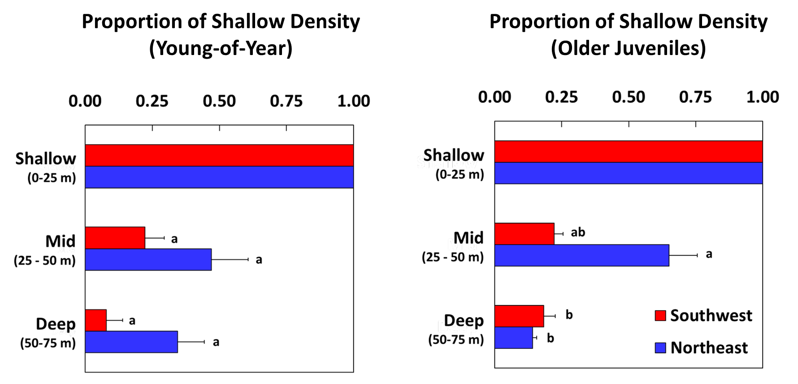
Settlement Regulation

Slide 25
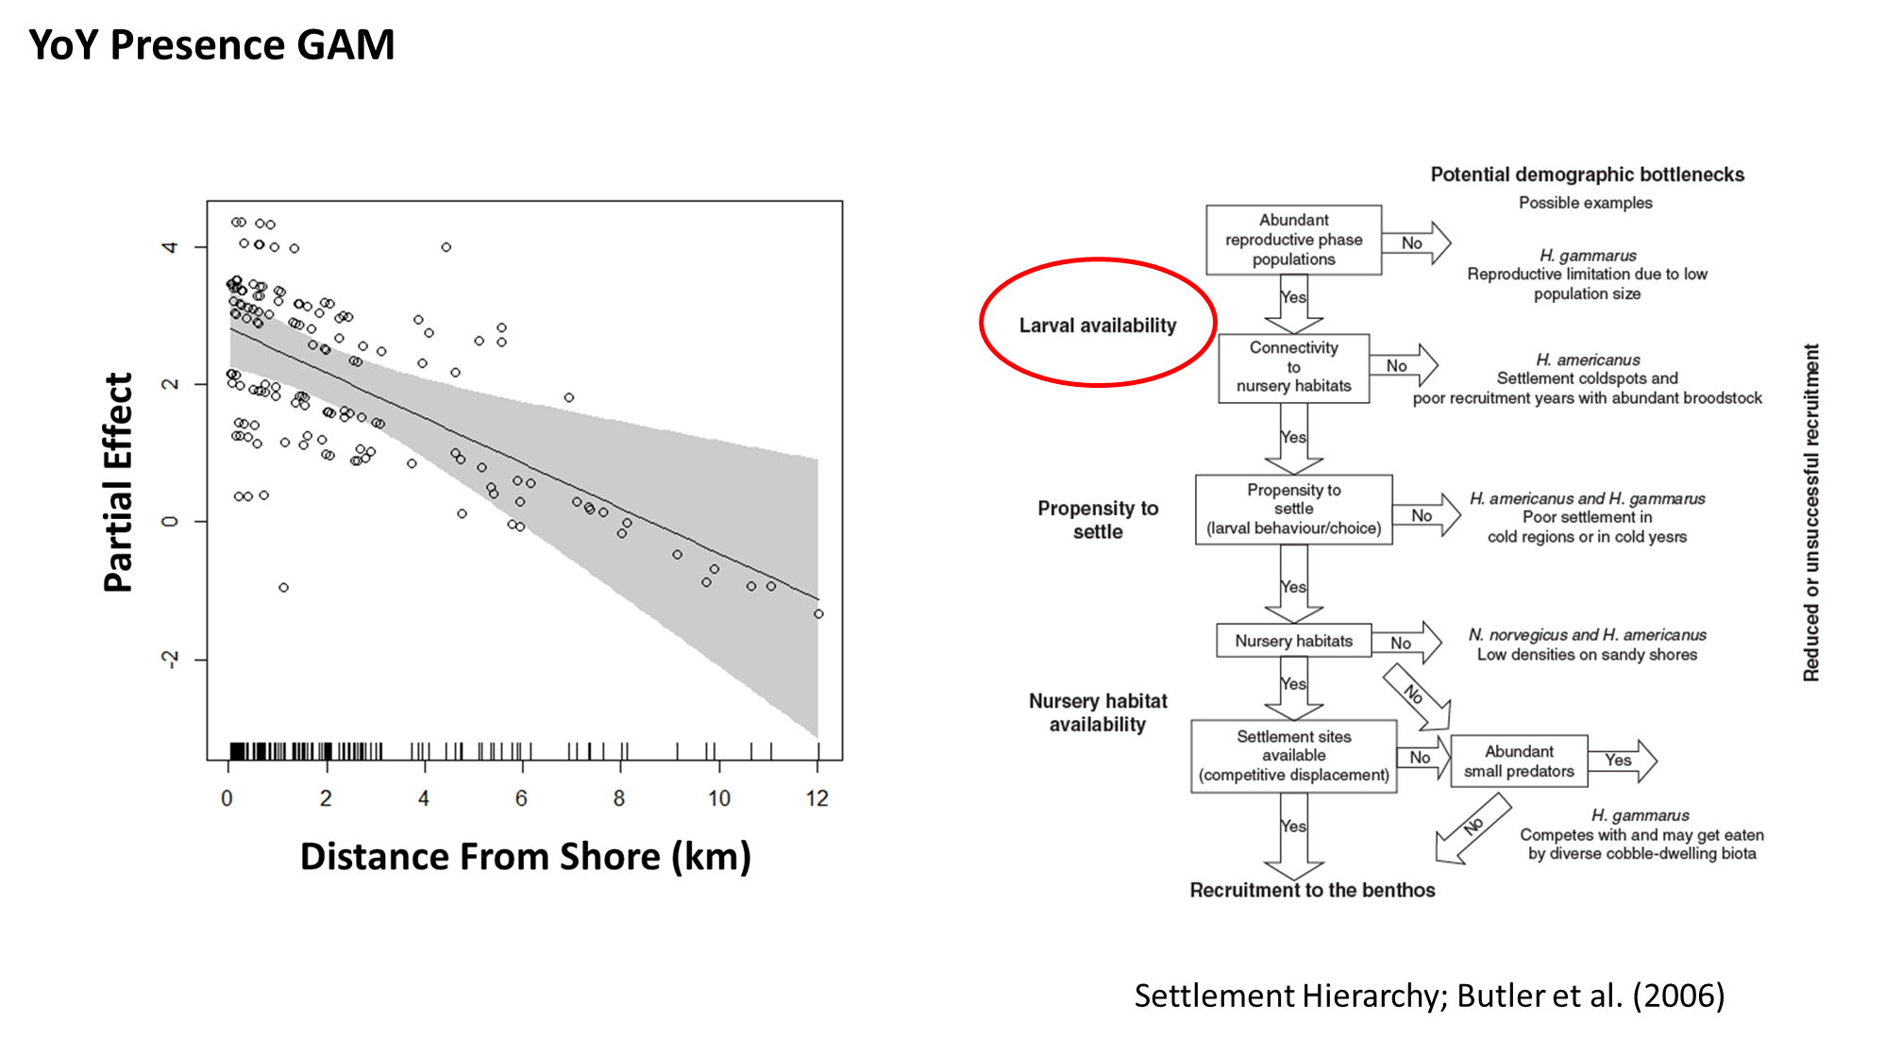
Settlement Regulation

Slide 26
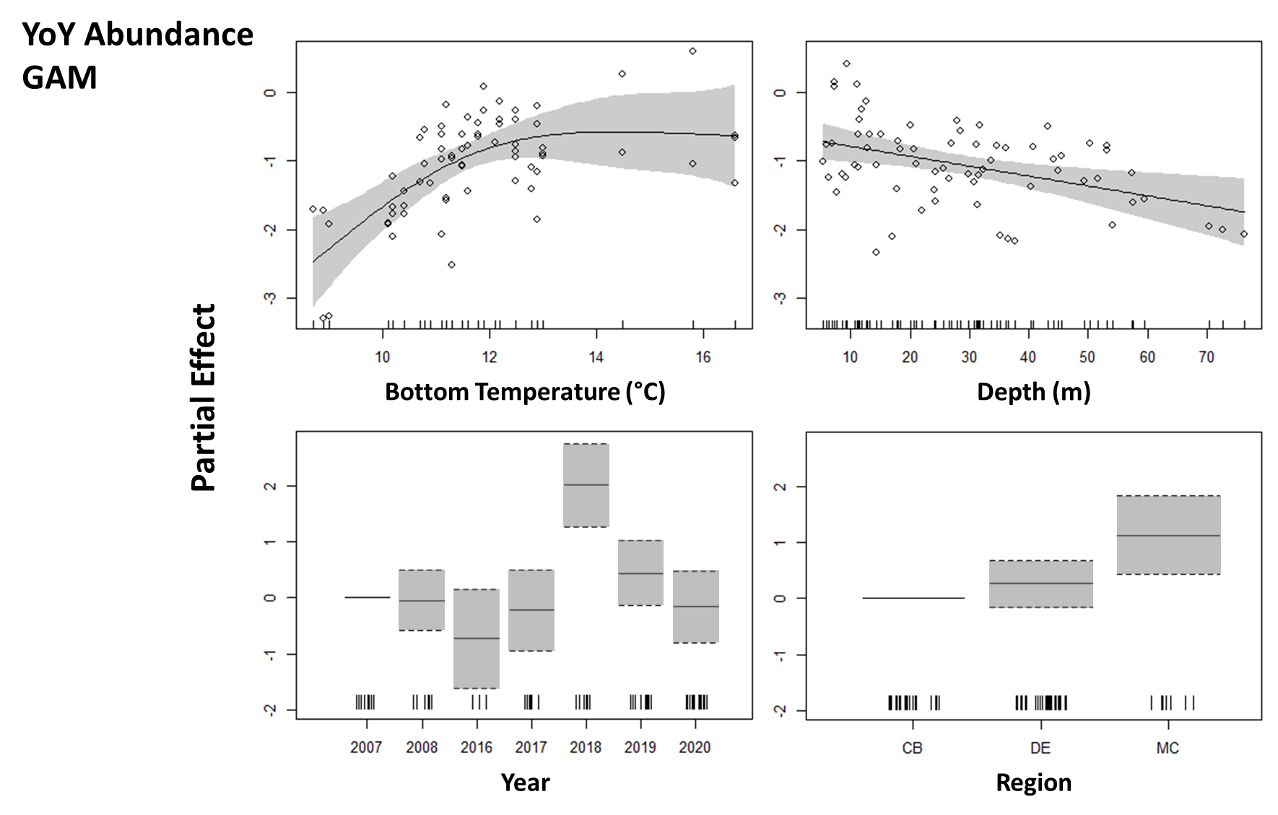
Settlement Regulation

Slide 27
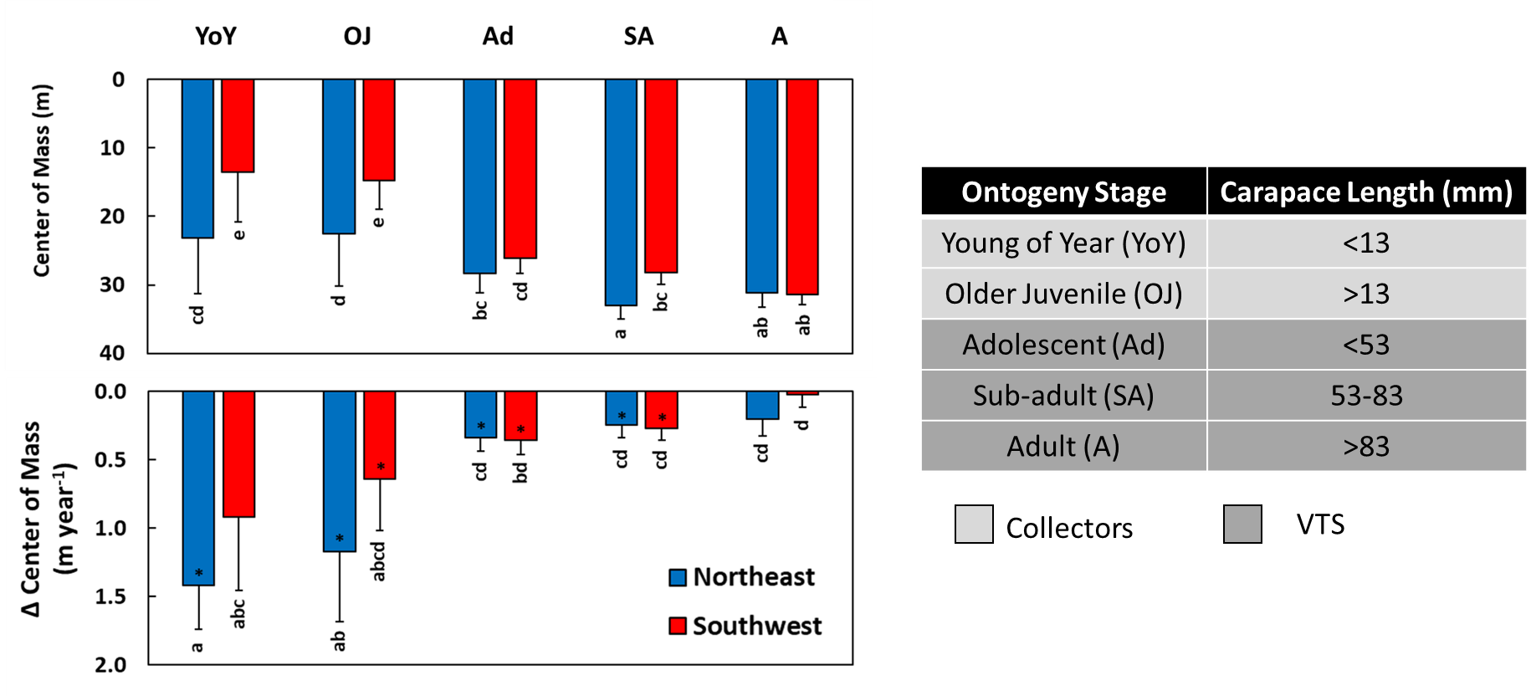
Settlement Regulation

Slide 28
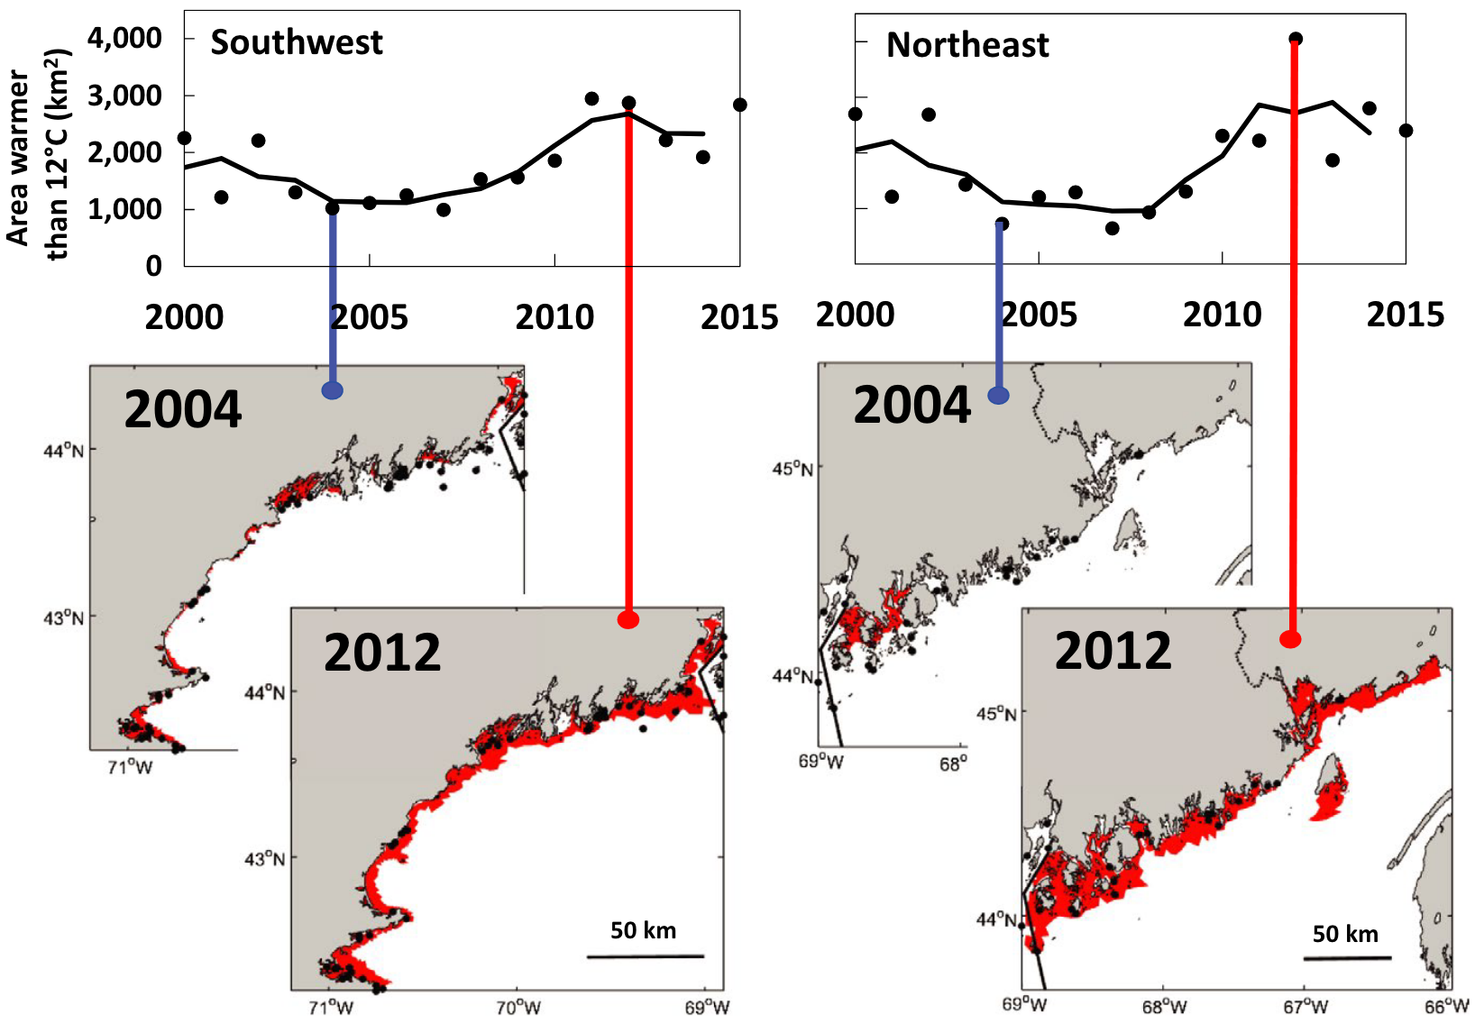
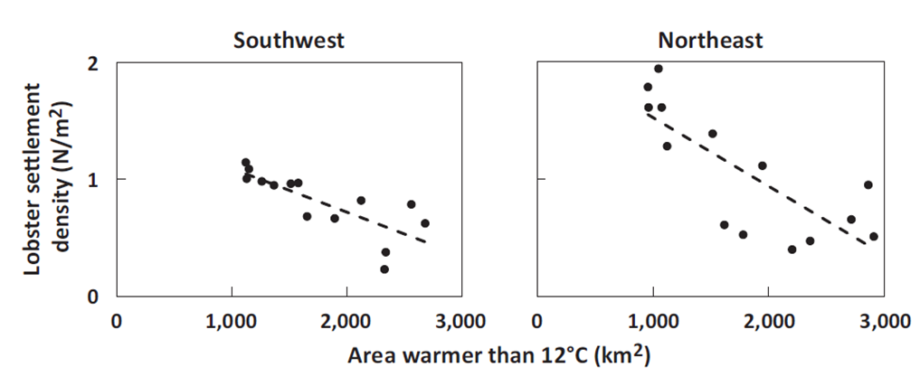
Settlement Regulation
Warming above 12°C expands available thermal habitat for postlarval settlement.
Warmer conditions expand available settlement habitat (Top), possibly regulating the area over which larvae are dispersed (left). Goode et al. (2019)

Slide 29
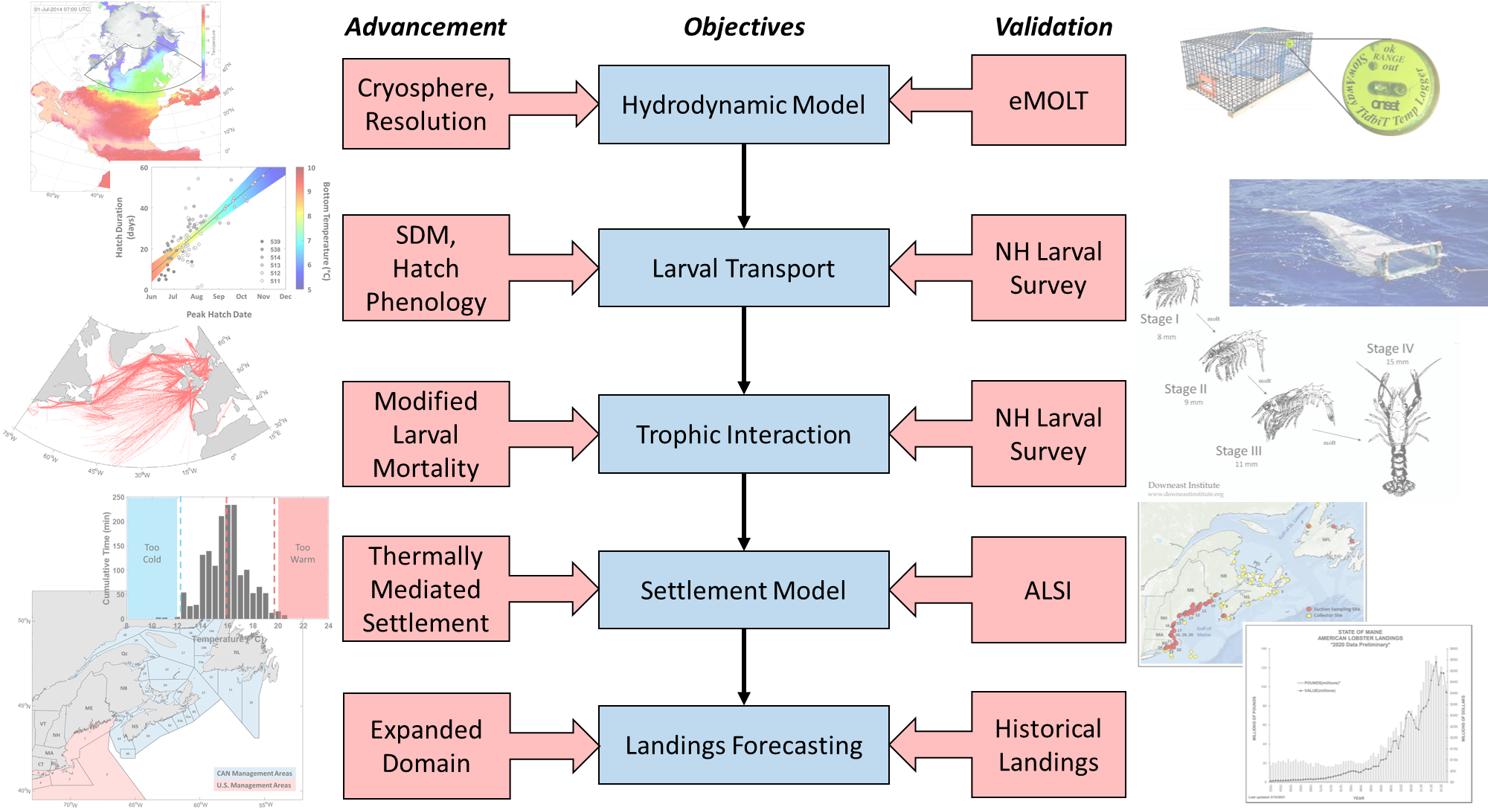
Takeaways
SSB
Changing HSIs in the central GOM makes habitat more accessible during Spring
Reproductive Phenology
Warming is shifting larval release earlier and over a shorter duration
Trophic Dynamics
Regional C. finmarchicus patterns correspond to settlement
Work being done to integrate patterns with larval model
Settlement Patterns
Settlement deeper can potentially utilize colder temperatures than previously thought
Integration = Difficult, but we’re refining our inputs to make everything as applicable as possible

Slide 30
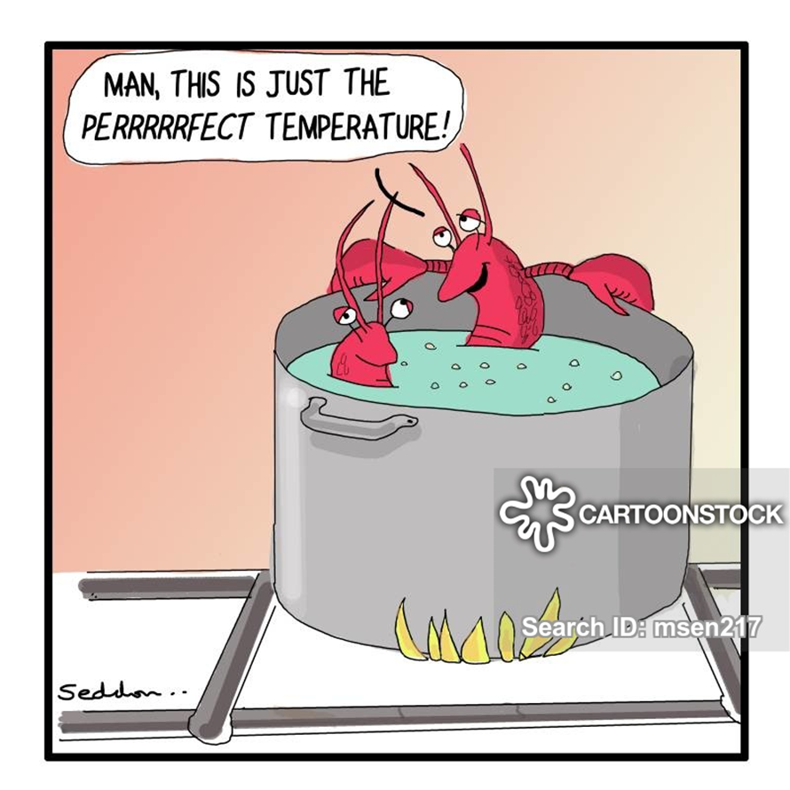

Questions?
Andrew Goode
https://www.researchgate.net/profile/Andrew-Goode
Everett Rzeszowski
https://www.researchgate.net/profile/Everett-Rzeszowski

